Slide 1
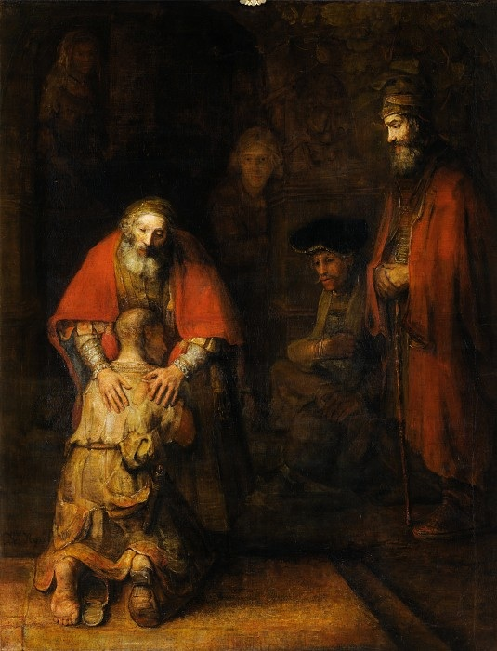
Penance & Reconciliation
Monday Reflection
Rembrandt

Slide 2
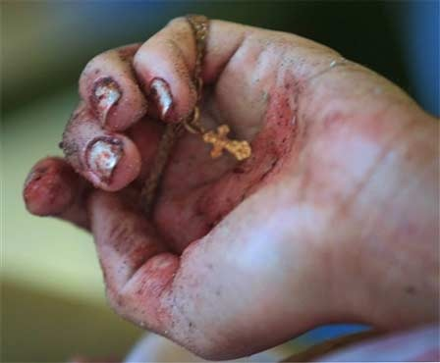
Reconciliation
Monday Prayers
Let us pray for those whom we will be helping by our charitable work this Lent. May our efforts bring them hope in their times of trial and hardship.
Lord, hear us…
Let us pray that we find the courage to observe Lent properly, and persevere in our Lenten resolutions.
Lord, hear us…
St. Philip: Pray for us.
House Saint: Pray for us.
In the name…

Slide 3
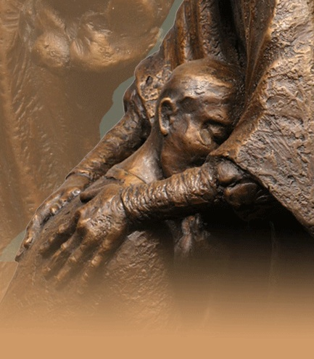
Reconciliation
Tuesday Reflection
Karen Schmidt

Slide 4
Reconciliation
Tuesday Prayers
Let us pray.
Let us ask God to help us examine our consciences and rediscover the desire for God to forgive us our trespasses.
Lord, hear us…
Let us pray that we find the courage to persevere in our Lenten resolutions.
Lord, hear us…
St. Philip: Pray for us.
House Saint: Pray for us.
In the name…

Slide 5
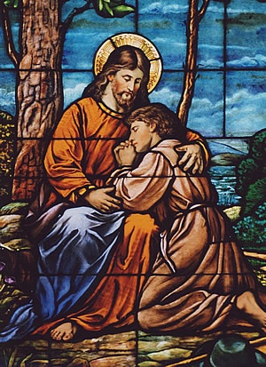
Reconciliation
Wednesday Reflection

Slide 6
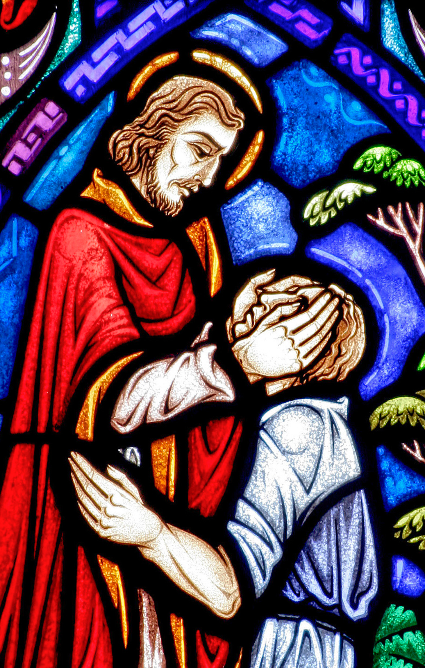
Reconciliation
Wednesday Prayers
Let us ask the Lord to free us from the temptations which will lead us into misery and into the slavery of sin.
Our Father…
St. Philip: Pray for us.
House Saint: Pray for us.
In the name…

Slide 7
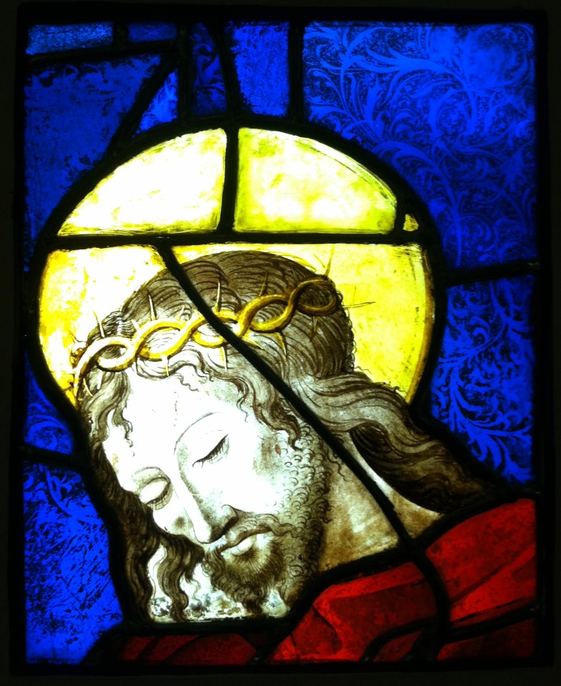
Reconciliation
Thursday Rosary
Third Sorrowful Mystery:
THE CROWNING WITH THORNS
After twisting some thorns into a crown, the soldiers put it on the head of Jesus.
They put a reed in his right hand and knelt before him and mocked him,
saying, ‘Hail, King of the Jews!’.

Slide 8
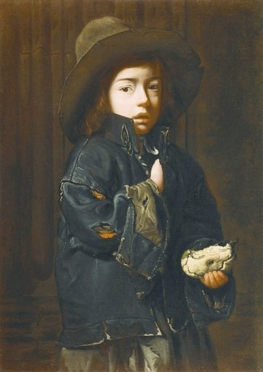
Friday Prayer
Remember that you can go to the Chapel for Confession this lunchtime.
Let us say the Act of Contrition together:
O my God,
I am truly sorry for having sinned against you,
and with the help of your grace,
I will try not to sin again.
Michael Sweerts

