Slide 1
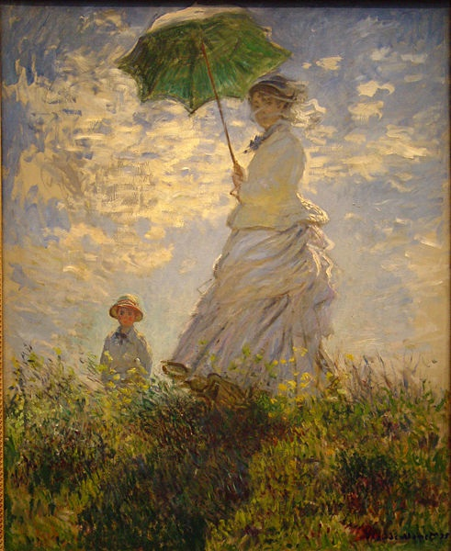
Prudence
Monday Reflection
Monet

Slide 2
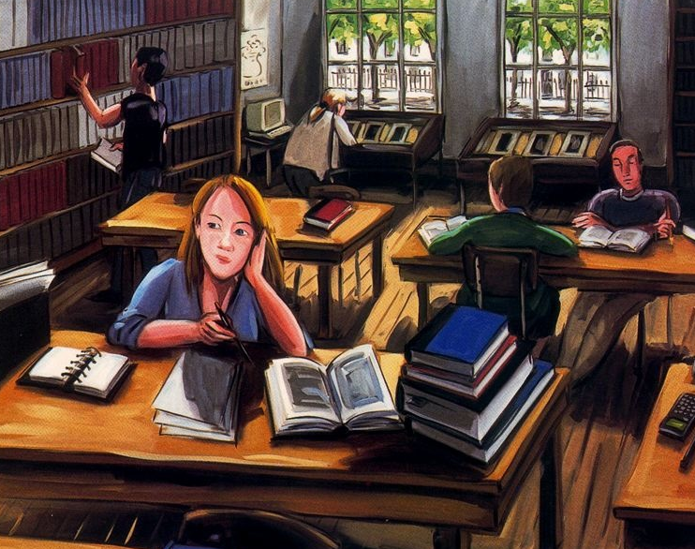
Prudence
Monday Prayers
Lisa Milroy
Let us pray that the leaders of the world act with true prudence, in order to bring about the betterment of society. Lord, hear us…
Let us pray that we be helped to acquire the virtue of Prudence in our time at school and in our preparations for life beyond school. Lord, hear us…
St. Philip: Pray for us. House Saint: Pray for us. In the name…

Slide 3
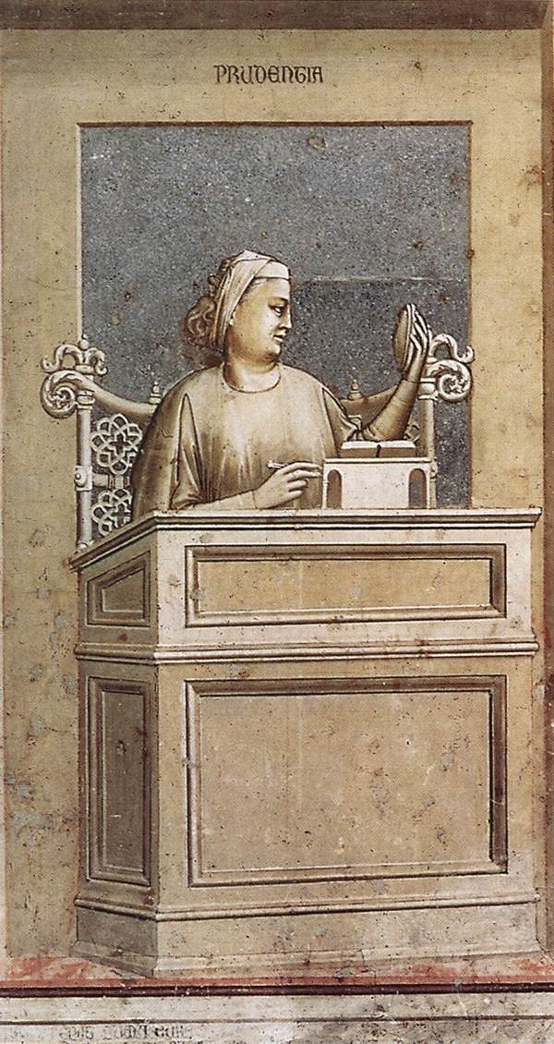
Prudence
Tuesday Reflection
Giotto

Slide 4
Prudence
Tuesday Prayers
We pray for those who teach us in school and for our parents;
May they help us to appreciate the importance of acting with prudence.
Lord, hear us…
Let us pray for our Holy Father Pope Leo, and for the the Bishops of the Church;
May they lead us to discover Christ as the Way, the Truth and the Life.
Lord, hear us…
St. Philip: Pray for us. House Saint: Pray for us.
In the name of the Father…
Giotto

Slide 5
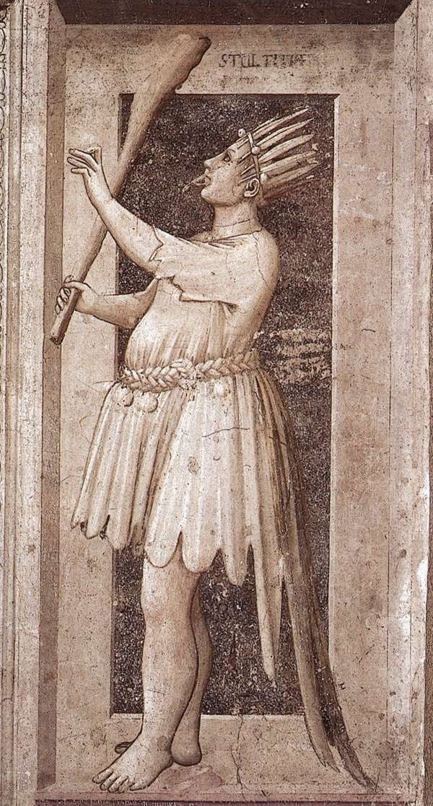
Prudence
Wednesday Reflection
Giotto

Slide 6
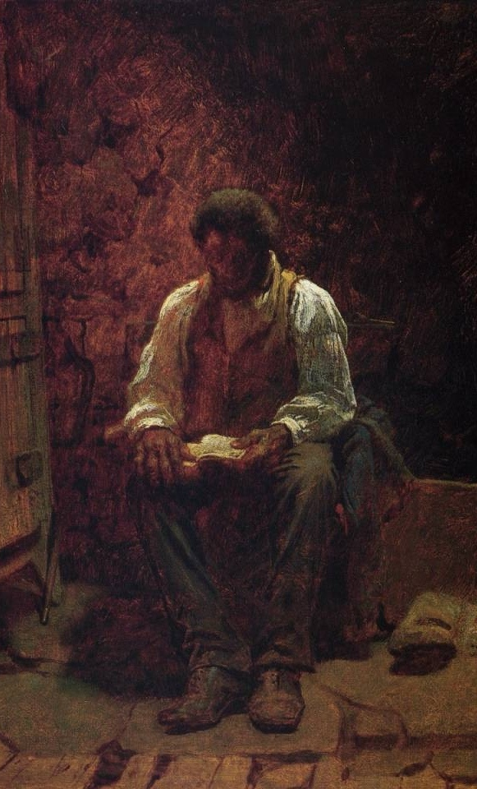
Prudence
Wednesday Prayers
Let us pray for those who live unhappy and fruitless lives;
May God help them discover their true dignity.
Lord hear us…
Let us pray for those of us who will sit public exams next summer; May they prepare for them with prudence.
Lord hear us…
St. Philip: Pray for us.
House Saint: Pray for us.
In the name of the Father…
Killingworth Johnson

Slide 7
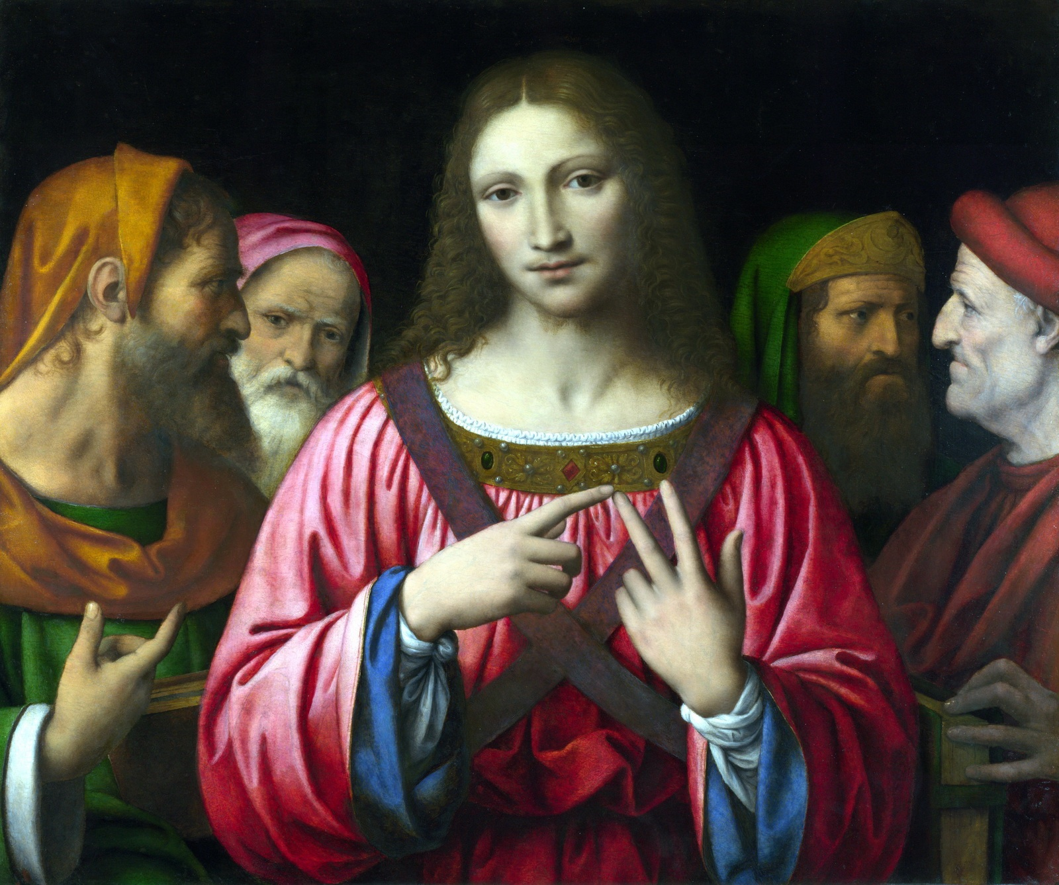
Prudence
Thursday Rosary
Fifth Joyful Mystery:
JESUS WAS FOUND IN THE TEMPLE
After three days Mary and Joseph found Jesus in the Temple, sitting among the teachers, listening to them and asking them questions. And all who heard him were amazed at his understanding and his answers.

Slide 8
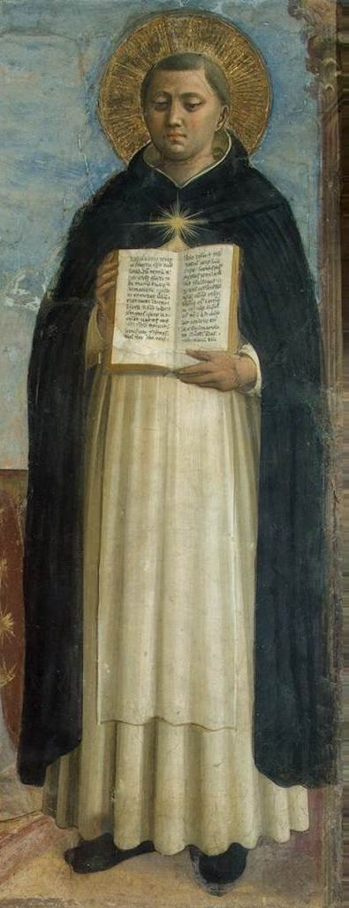
St Thomas Aquinas Prayer for Students
Ineffable Creator,
Pour forth a ray of your brightness
into the darkened places of my mind;
disperse from my soul the twofold darkness into which I was born:sin and ignorance.
You make eloquent the tongues of infants:
Refine my speech
and pour forth upon my lips the goodness of Your blessing.
Grant to me keenness of mind,
capacity to remember,
skill in learning,
subtlety to interpret,
and eloquence in speech.
May You guide the beginning of my work,
direct its progress, and bring it to completion.
You who are true God and true Man,
Who live and reign, world without end.
Amen.

