Slide 1
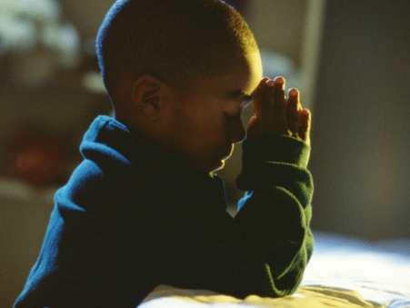
The Paraclete
Monday Reflection

Slide 2
The Paraclete
Monday Prayers
Let us pray for Pope Leo and for the Bishops of the Church;
May they be inspired by the Holy Spirit in their guidance of the Church.
Lord, hear us…
St Philip: Pray for us.
House Saint: Pray for us.
In the name…

Slide 3
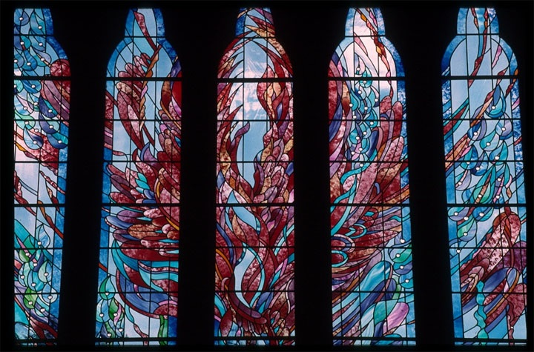
The Paraclete
Tuesday Reflection

Slide 4
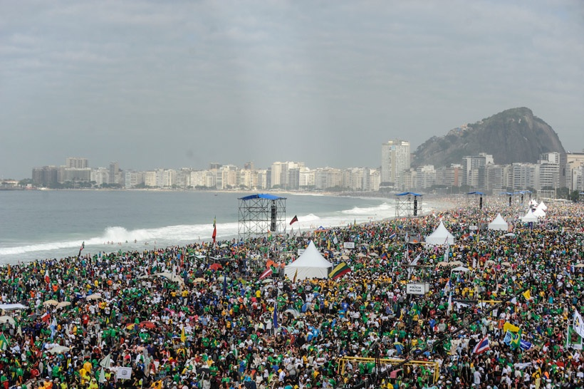
The Paraclete
Tuesday Prayers
World Youth Day 2014
Let us pray for the Universal Church,
that all the peoples of the world who are united within her, grow in support of each other and learn to spread the Gospel of Christ more effectively.
Lord, hear us….
St Philip: Pray for us. House Saint: Pray for us. In the name…

Slide 5
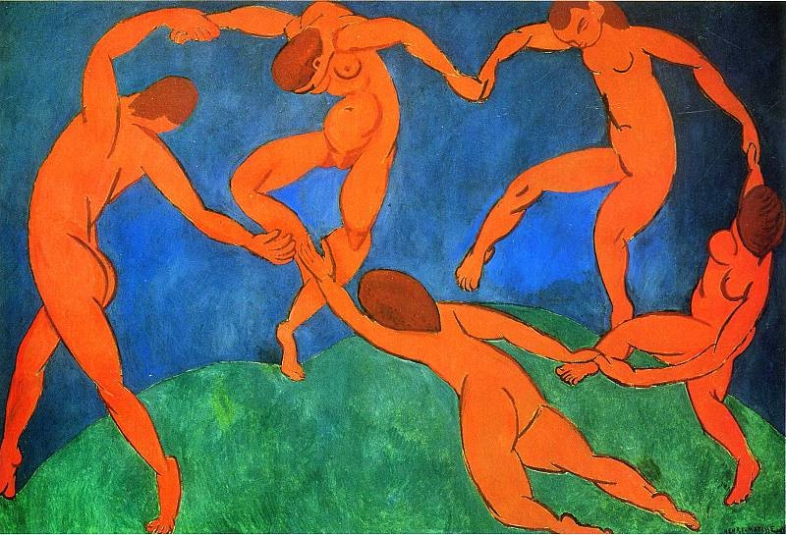
The Paraclete
Wednesday Reflection
Matisse

Slide 6
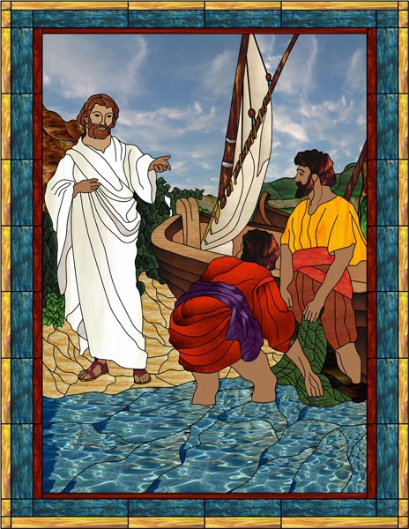
The Paraclete
Wednesday Prayers
Let us pray that members of our school might be inspired by the Holy Spirit to offer their talents for the spreading of there Gospel.
Lord, hear us…
St Philip: Pray for us.
House Saint: Pray for us.
In the name…

Slide 7
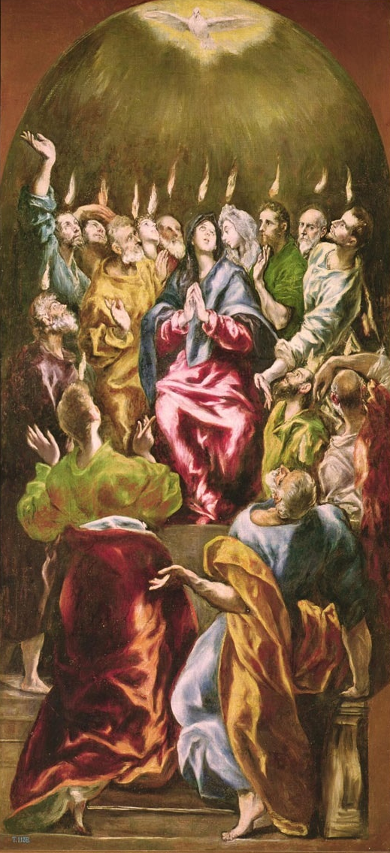
The Paraclete
Thursday Rosary
The Third Glorious Mystery:
THE DESCENT OF THE HOLY SPIRIT
Divided tongues, as of fire, appeared among them, and a tongue rested on each of them.
They were filled with the Holy Spirit.
El Greco

Slide 8
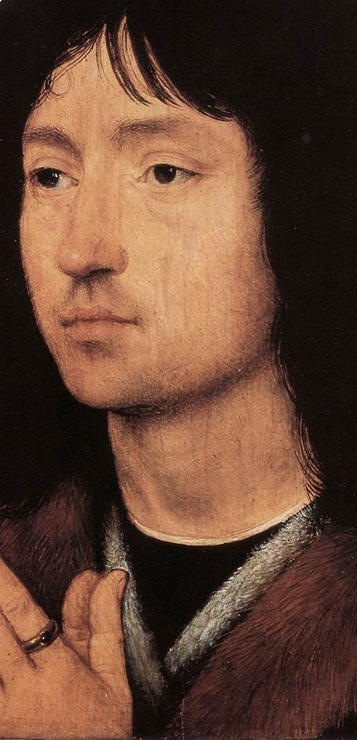
Friday Prayer
Remember that you can go to the Chapel for Confession this lunchtime.
PRAYER TO THE HOLY SPIRIT
V. Come, Holy Spirit, fill the hearts of your faithful
R. And kindle in them the fire of your love. V. Send forth your Spirit and they shall be created
R. And you will renew the face of the earth.
Let us pray.
Lord, by the light of your Holy Spirit you have taught the hearts of your faithful.
In that same Spirit help us to relish what is right and always rejoice in your consolation.
We ask this through Christ our Lord. Amen.
Memling

