Slide 1
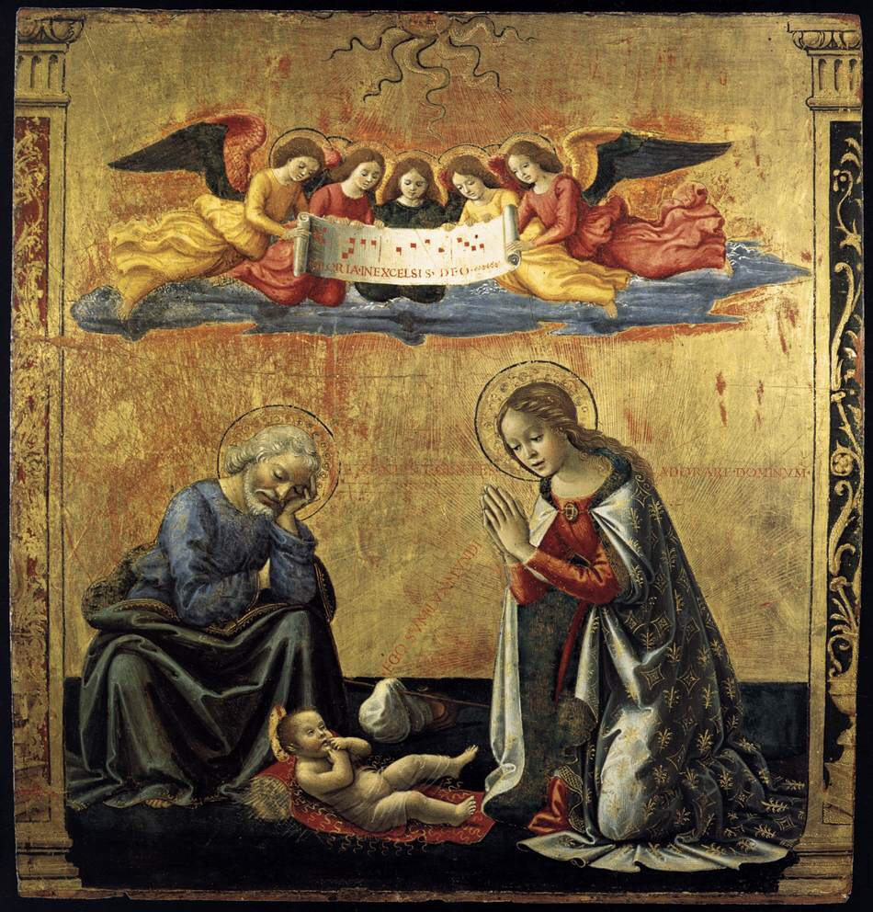
Nativity
Monday Reflection
Ghirlandaio

Slide 2
Nativity
Monday Prayers
Let us pray for our parents and our families, that we model ourselves more on the Holy Family, as we celebrate Christmas.
Lord hear us…
Let us pray for those for whom we are collecting this Advent, that they find the warmth of God’s love in the care they receive at The Passage.
Lord hear us…
Our Lady, Mather of God: Pray for us.
St Joseph: Pray for us.
In the name…

Slide 3
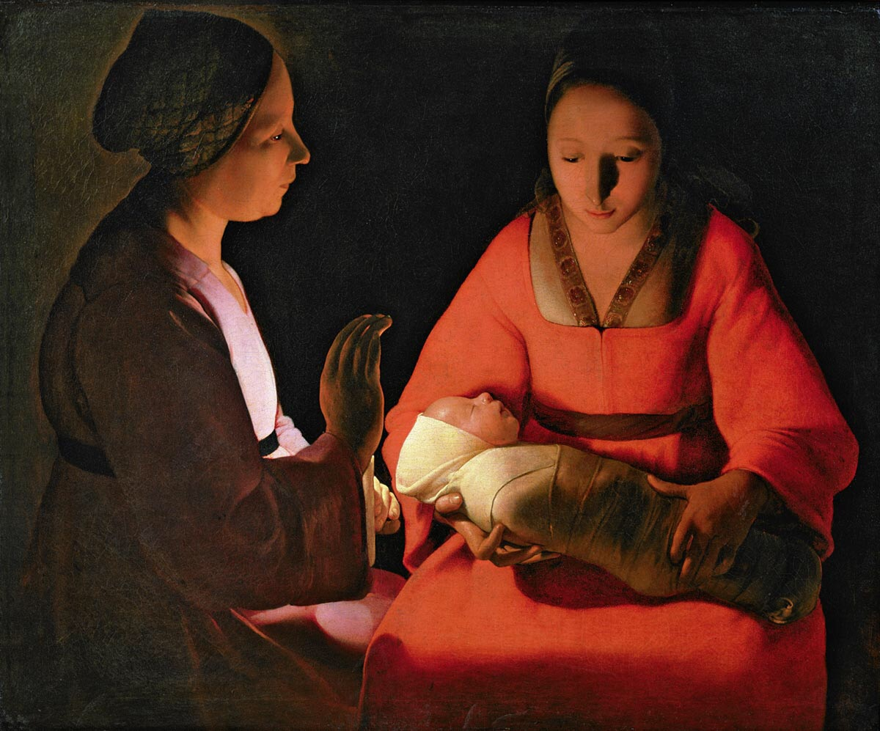
Nativity
Tuesday Reflection
Georges de la Tour

Slide 4
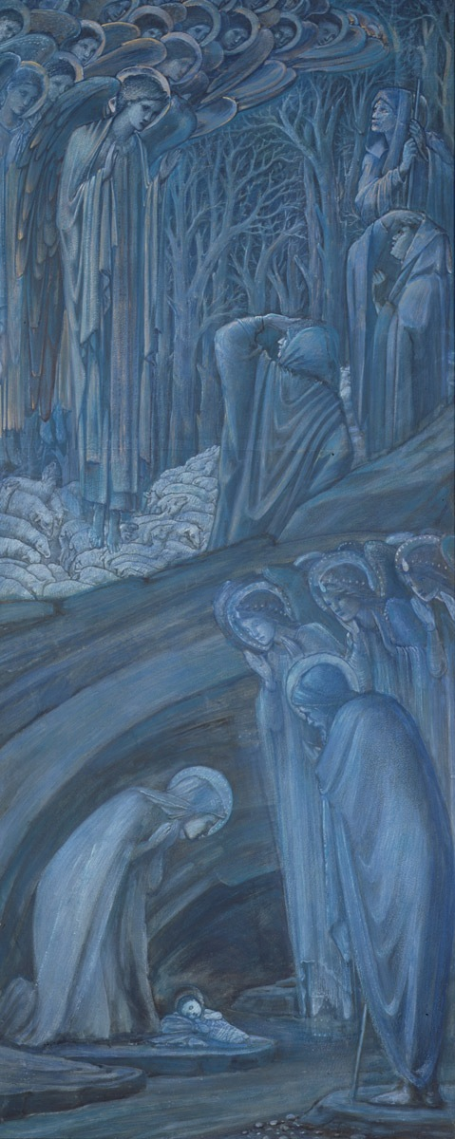
Christmas & Humility
Tuesday Prayers
Let us pray for our parents and our families, that we model ourselves more on the Holy Family, as we celebrate Christmas.
Lord hear us…
Let us pray for those for whom we are collecting this Advent, that they find the warmth of God’s love in the care they receive at The Passage.
Lord hear us…
Our Lady, Mather of God: Pray for us.
St Joseph: Pray for us.
In the name…

Slide 5
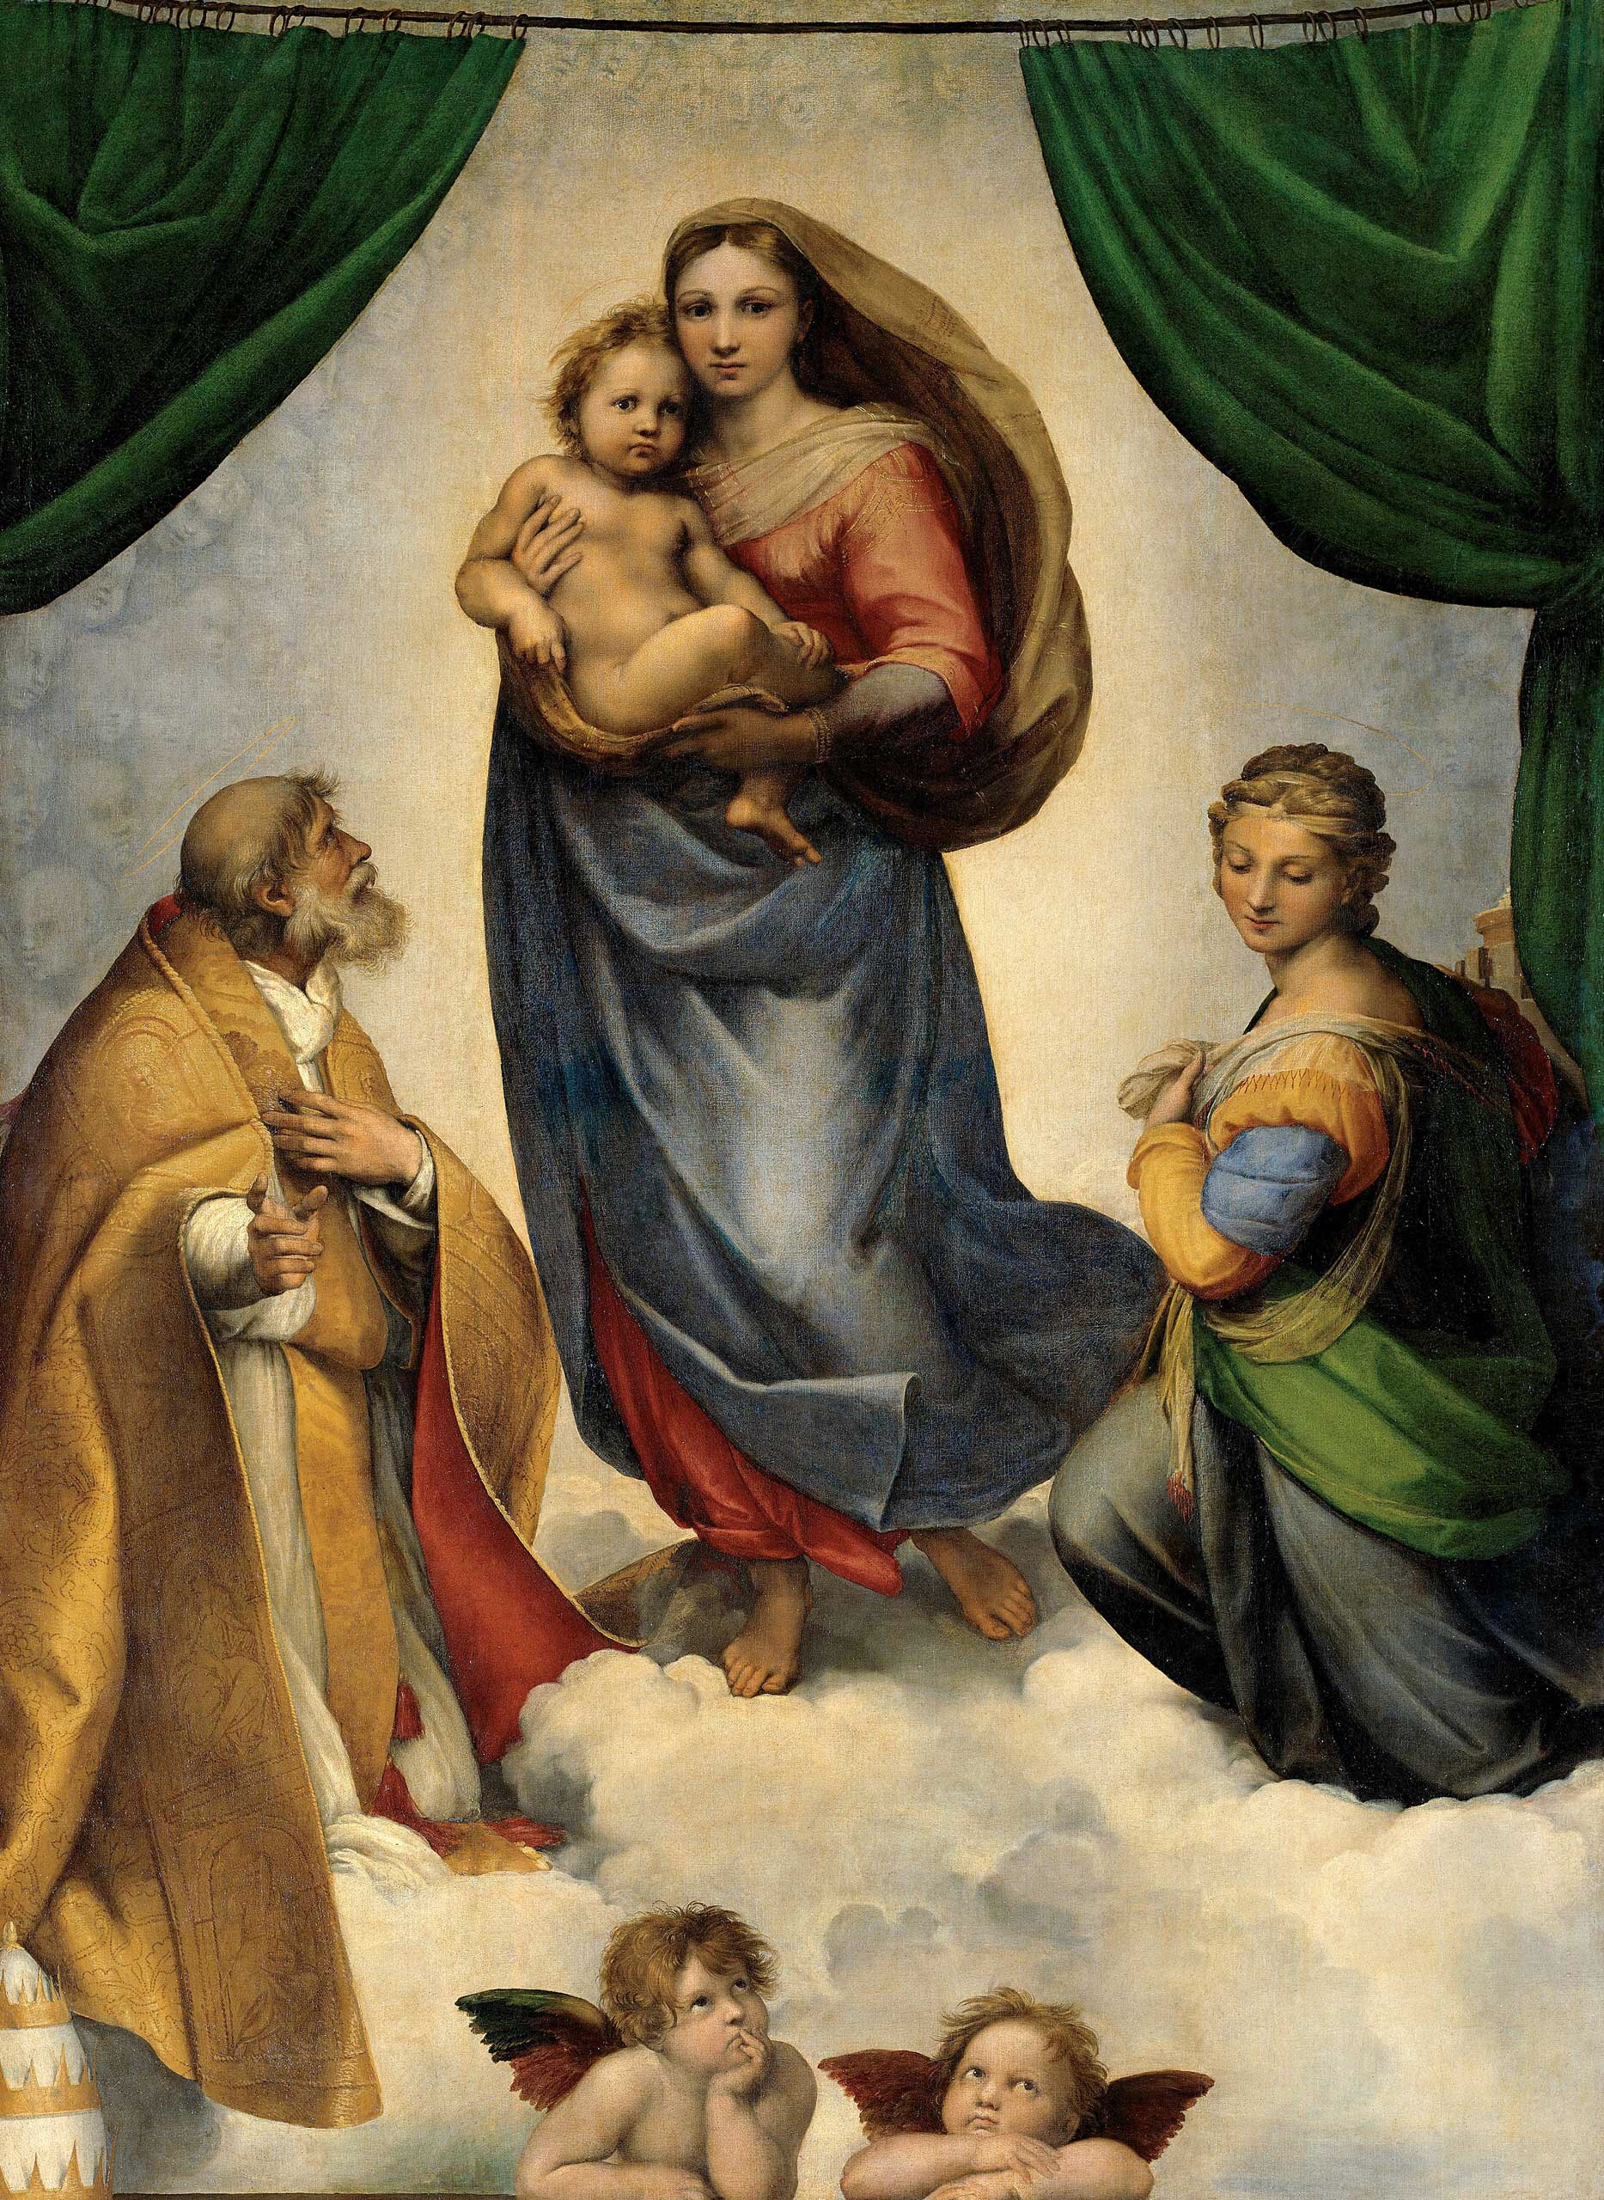
Christmas & Humility
Wednesday Reflection
Raphael

Slide 6
Nativity
Wednesday Prayers
Let us pray for our parents and our families, that we model ourselves more on the Holy Family, as we celebrate Christmas.
Lord hear us…
Let us pray for those for whom we are collecting this Advent, that they find the warmth of God’s love in the care they receive at The Passage.
Lord hear us…
Our Lady, Mather of God: Pray for us.
St Joseph: Pray for us.
In the name…

