Slide 1
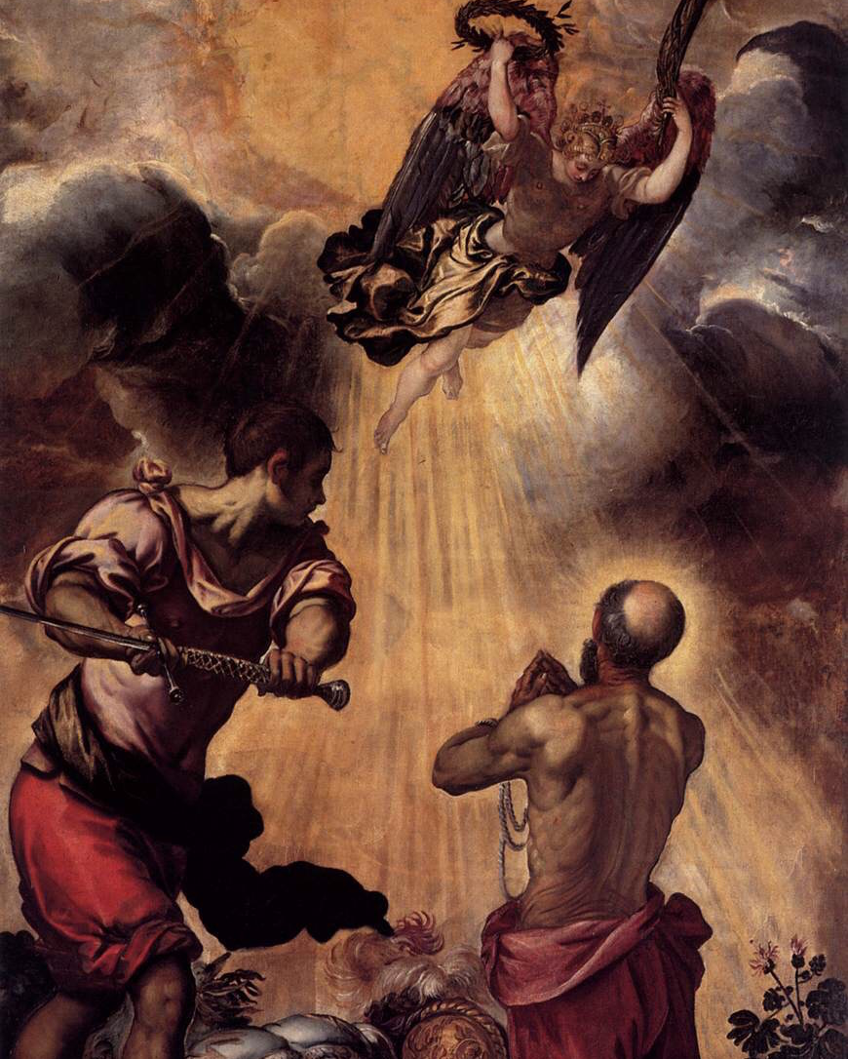
Missionaries
Monday Reflection
Tintoretto

Slide 2
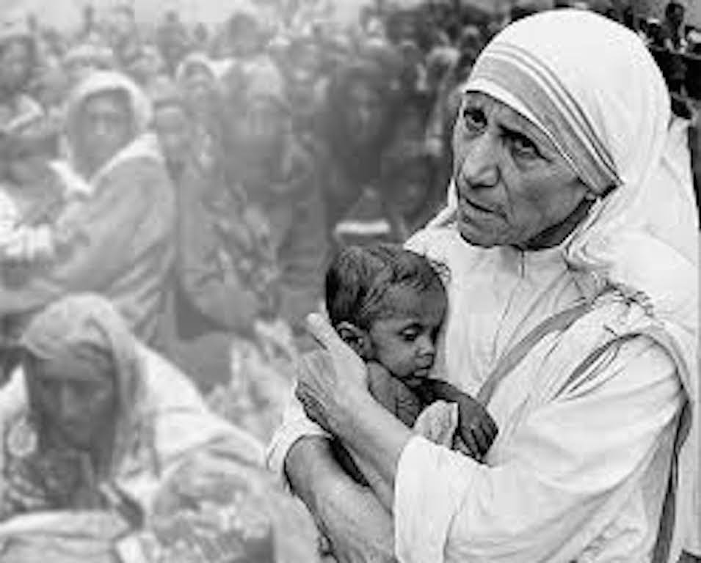
Monday Prayers
Mother Teresa of Culcutta
Let us pray for those who work as Missionaries, living far from their homes, learning to rely only on the grace of God in their work. May they be rewarded in heaven for their work on earth. Lord, hear us...
Let us pray for those who are called upon to bear witness to their faith in times of persecution, especially the Christians in the Middle East.
May they find the courage which inspired Saint Paul, and also the martyrs who shed their blood for England. Lord hear us…
St Philip: Pray for us.
St Paul the Apostle: Pray for us.
In the name…

Slide 3
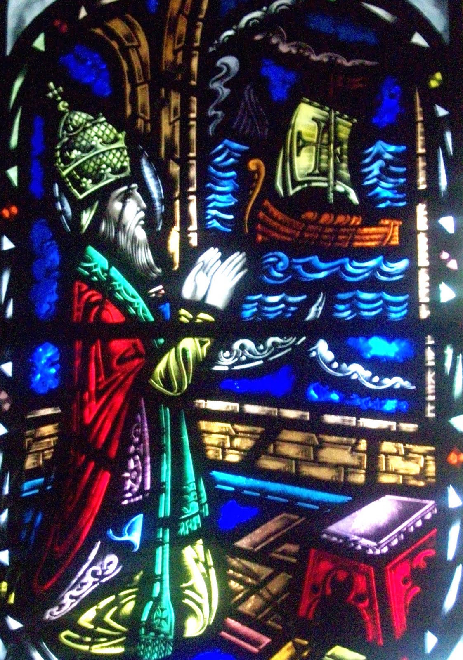
Missionaries
Tuesday Reflection
St Gregory sends Missionaries to England

Slide 4
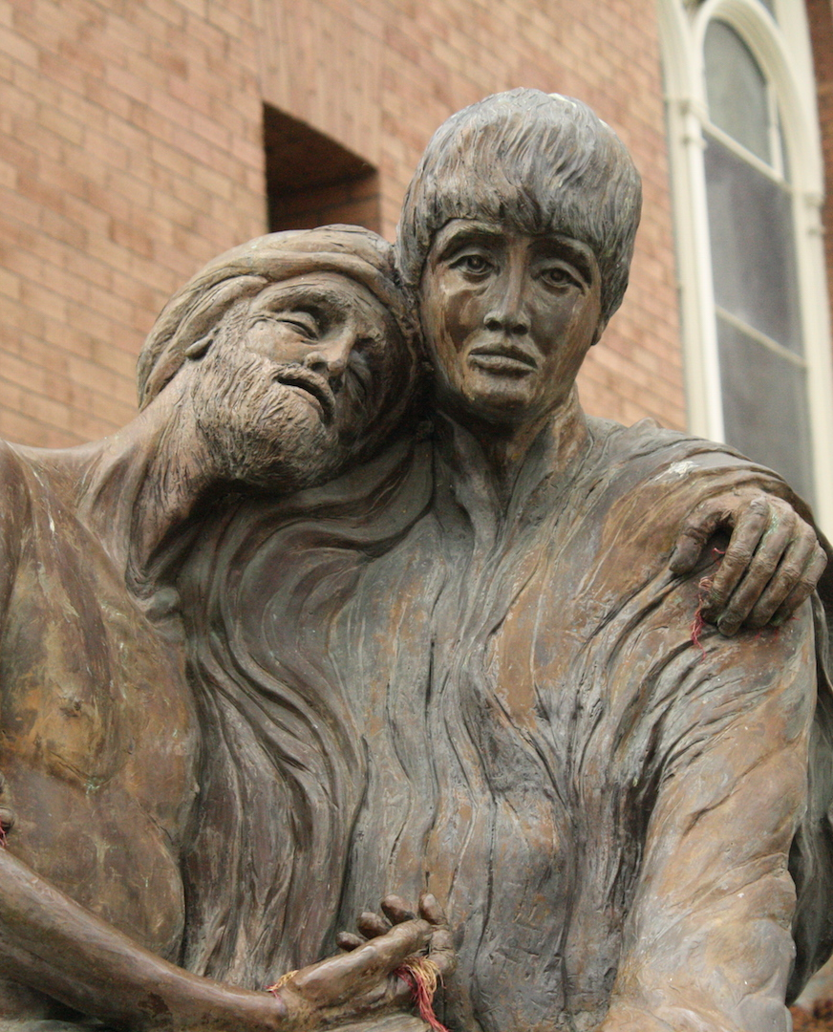
Missionaries
Tuesday Prayers
Let us pray for those who live near to us and yet are living on the margins of society: The homeless, the broken hearted, the unemployed, those in prison and those suffering sickness.
May they find consolation in the Good News which Christ brings.
Lord hear us…
Let us pray for those suffering from depression and mental afflictions which drive them to despair;
May they be given the gift of Hope.
Lord, hear us…
St Philip: Pray for us,
St Paul the Apostle : Pray for us.
In the name…
St. Aloysius Gonzaga

Slide 5
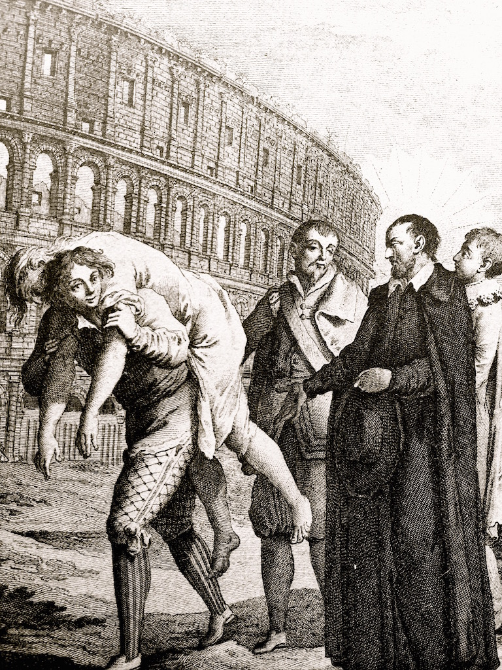
Missionaries
Wednesday Reflection
St Philip in Rome

Slide 6
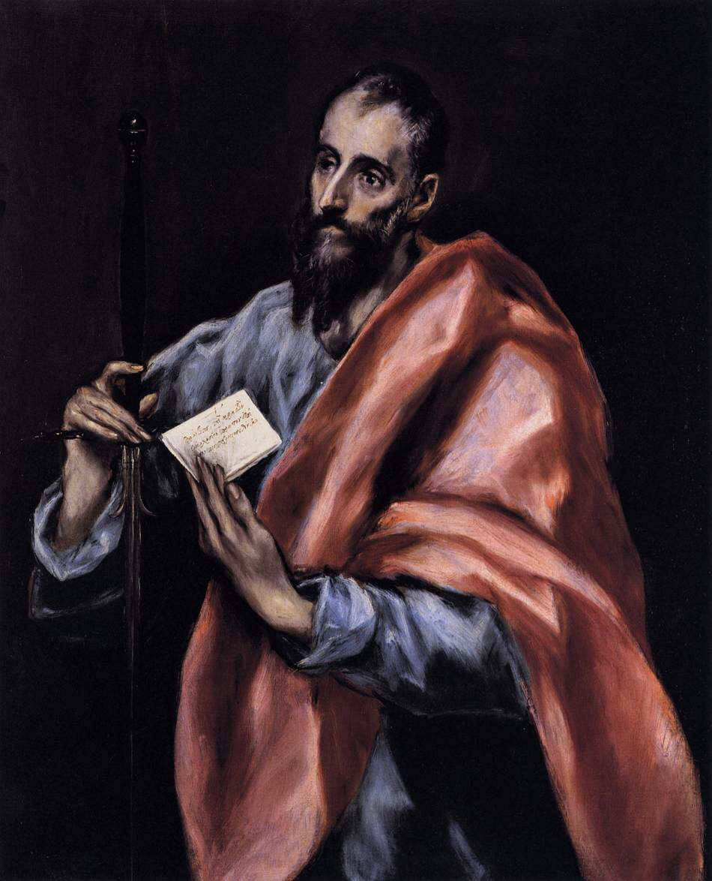
Missionaries
Wednesday Prayers
Let us pray for each other, that God’s Will be done in our lives, as we say
Our Father…
St Philip: Pray for us,
St Paul the Apostle: Pray for us.
In the name….
El Greco

Slide 7
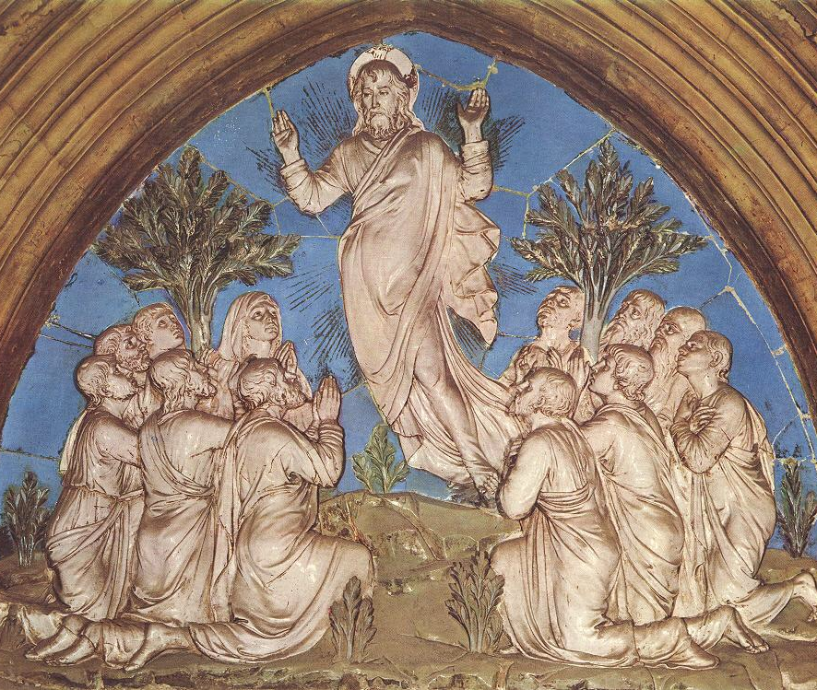
Prudence
Thursday Rosary
Luca Della Robbia
The Second Glorious Mystery:
THE ASCENSION
Jesus said “Go make disciples of all nations; baptise them in the name of the Father and of the Son and of the Holy Spirt, and teach them to observe all I gave you. And know that I am with you always, even to the end of time”

Slide 8
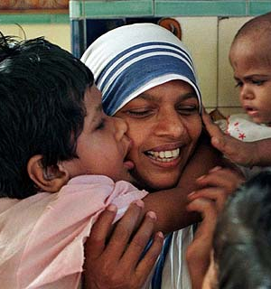
Missionaries of Charity Prayer
This prayer is prayed by Mother Teresa’s nuns
every morning before they start their work amongst the marginalised.
Dear Lord, the Great Healer,
I kneel before You.
Since every perfect gift must come from You,
I pray, give skill to my hands,
clear vision to my mind,
kindness and meekness to my heart.
Give me singleness of purpose,
strength to lift up a part of the burden
of my suffering fellow men,
and a true realization of the privilege that is mine.
Take from my heart all guile and worldiness,
that with the simple faith of a child,
I may rely on You.
Amen.

