Slide 1
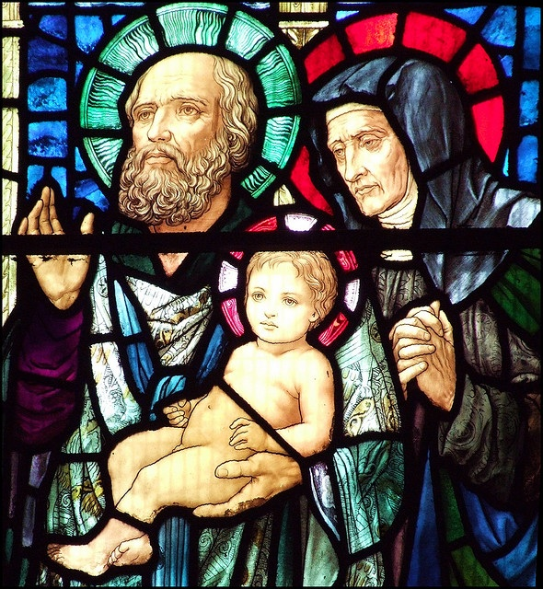
Light
Monday Reflection

Slide 2
Light
Monday Prayers
Let us give thanks to Almighty God for shedding the light of His Beloved Son into the world.
Our Father…
St Simeon: Pray for us.
In the name…

Slide 3
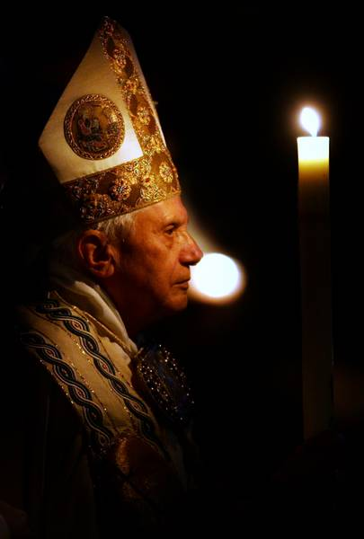
Light
Tuesday Reflection
Candlemas 2013

Slide 4
Light
Tuesday Prayers
Let us pray for Pope Leo, that he be confirmed in his faith, and that he leads the Church with wisdom and courage.
Lord, hear us…
Let us pray for our Bishops and priests, that they be inspired to present the teachings of the church for those who live in this land, as the only light worth following.
Lord, hear us…
St. Philip: Pray for us.
House Saint: Pray for us.
In the name…

Slide 5
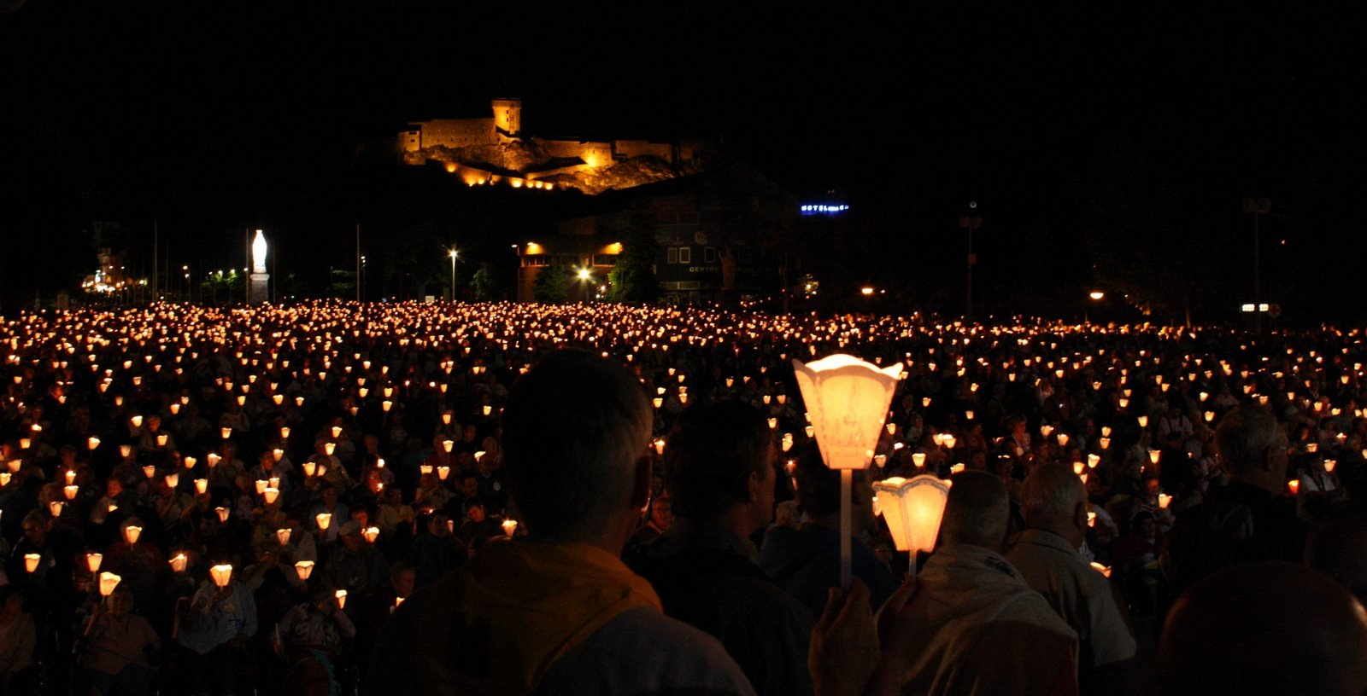
Light
Wednesday Reflection
Torchlight Procession, Lourdes

Slide 6
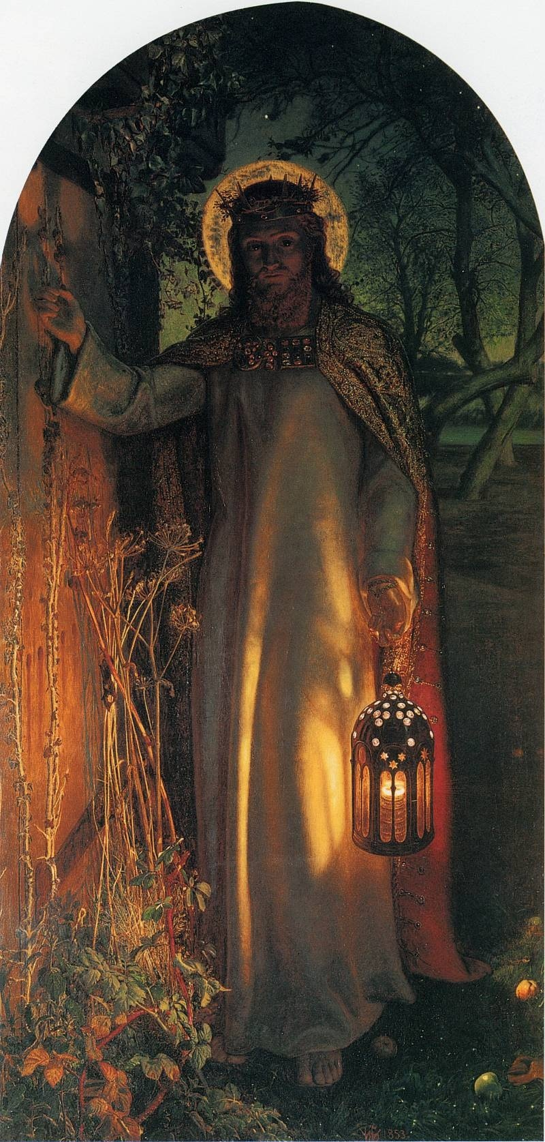
Light
Wednesday Prayers
Let us ask our Lady, Morning Star, to guide us towards the light of her Son.
Hail Mary…
In the name…
Holman Hunt

Slide 7
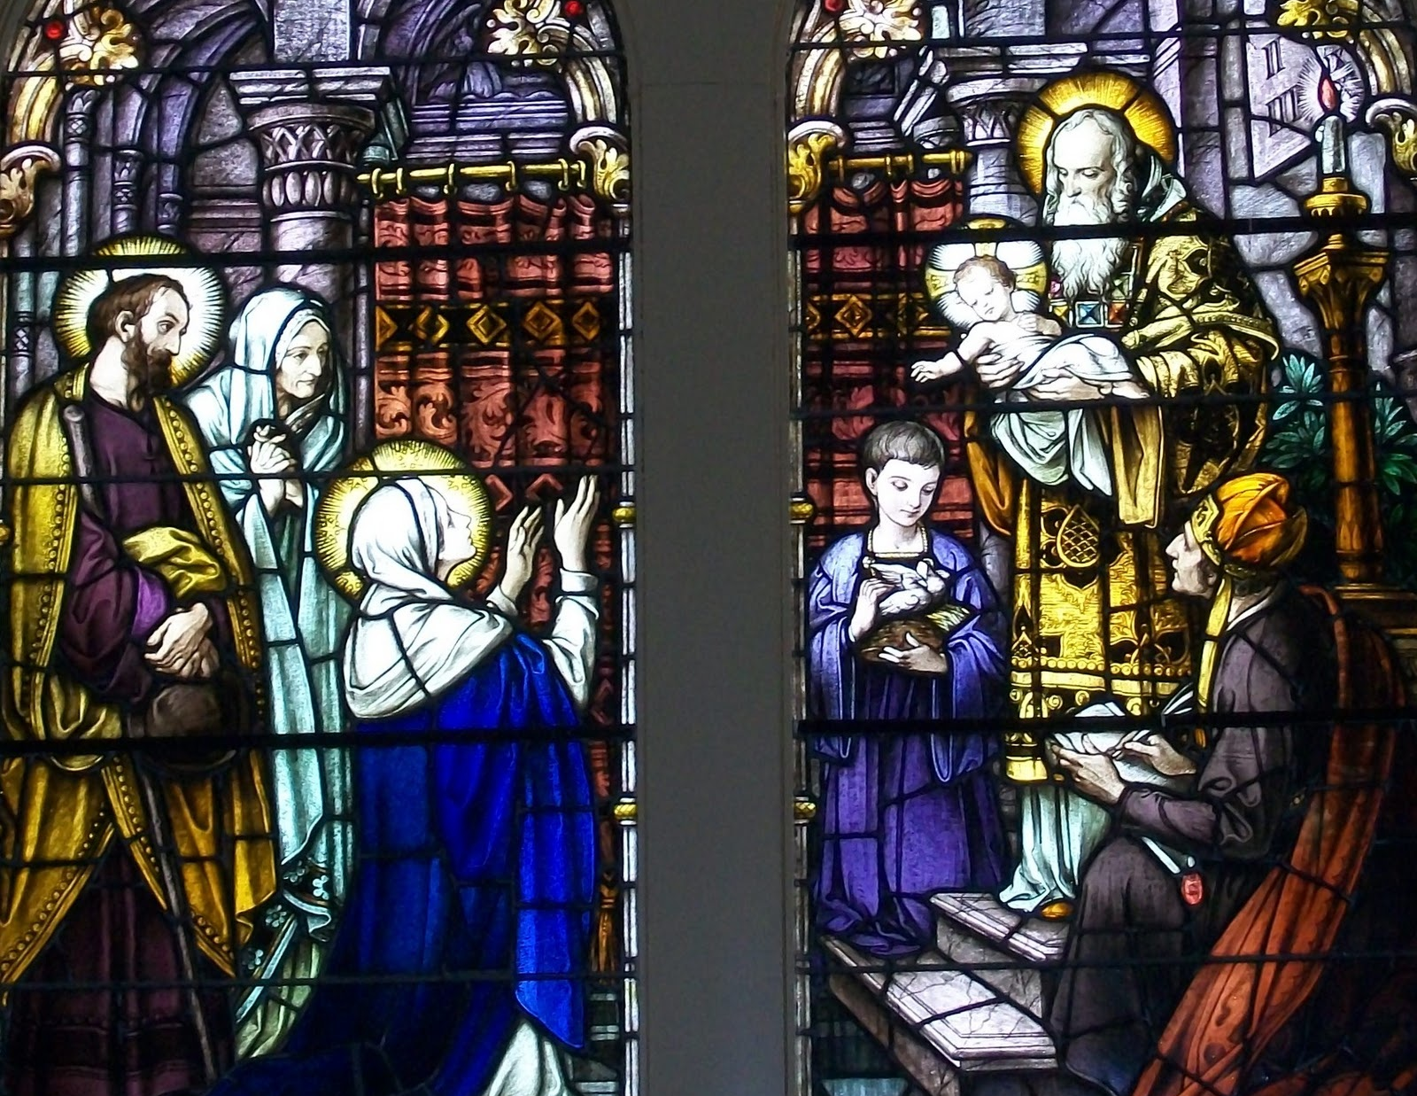
Light
Thursday Rosary
The Fifth Joyful Mystery:
THE FINDING OF JESUS IN THE TEMPLE
Simeon took Jesus in his arms and praised God, saying,
‘Master, now you are dismissing your servant in peace, according to your word; for my eyes have seen your salvation, a light for revelation to the Gentiles and for glory to your people Israel.

Slide 8
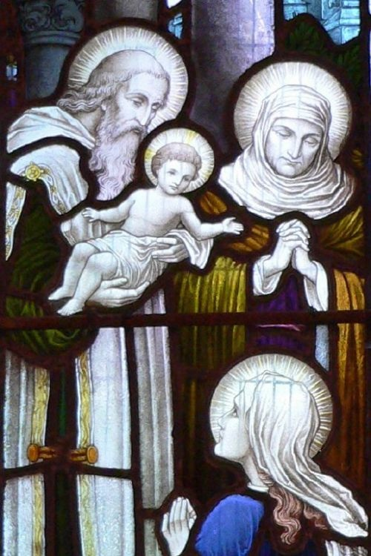
Friday Prayer
Remember that you can go to the Chapel for Confession this lunchtime.
Simeon’s Prayer
THE NUNC DIMITIS
At last, all-powerful Master,
you give leave to your servant
to go in peace, according to your promise.
For my eyes have seen your salvation
which you have prepared for all nations,
the light to enlighten the Gentiles
and give glory to Israel, your people.
Glory be…

