Slide 1
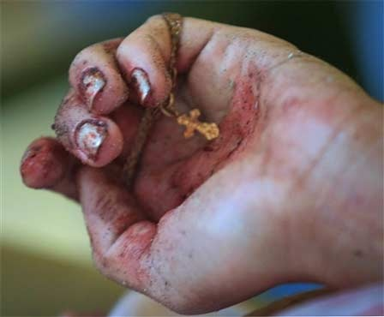
Lent
Monday Reflection

Slide 2
Lent
Monday Prayers
Let us pray for those whom we will be helping by our charitable work this Lent.
May our efforts bring them hope in their times of trial and hardship.
Lord, hear us…
Let us pray that we find the courage to observe Lent properly, and persevere in our Lenten resolutions.
Lord, hear us…
St. Philip: Pray for us.
House Saint: Pray for us.
In the name…

Slide 3
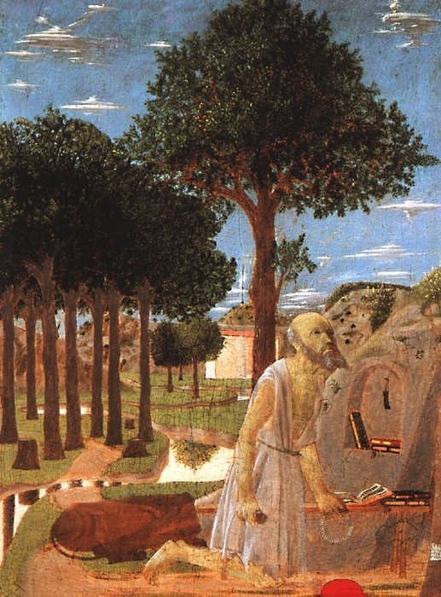
Lent
Tuesday Reflection
Piero della Francesca

Slide 4
Lent
Tuesday Prayers
Let us pray for those whom we will be helping by our charitable work this Lent.
May our efforts bring them hope in their times of trial and hardship.
Lord, hear us…
Let us pray that we find the courage to observe Lent properly, and persevere in our Lenten resolutions.
Lord, hear us…
St. Philip: Pray for us.
House Saint: Pray for us.
In the name…

Slide 5
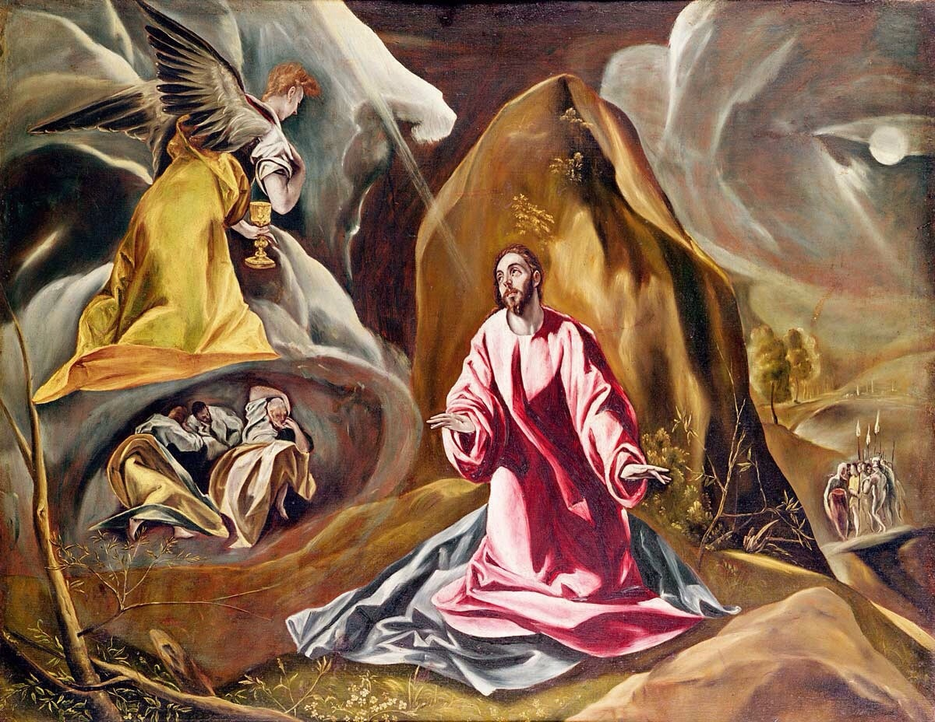
Lent
Thursday Rosary
El Greco
First Sorrowful Mystery:
THE AGONY IN THE GARDEN
In his anguish, Jesus prayed more earnestly, and his sweat became like great drops of blood falling down on the ground.

Slide 6
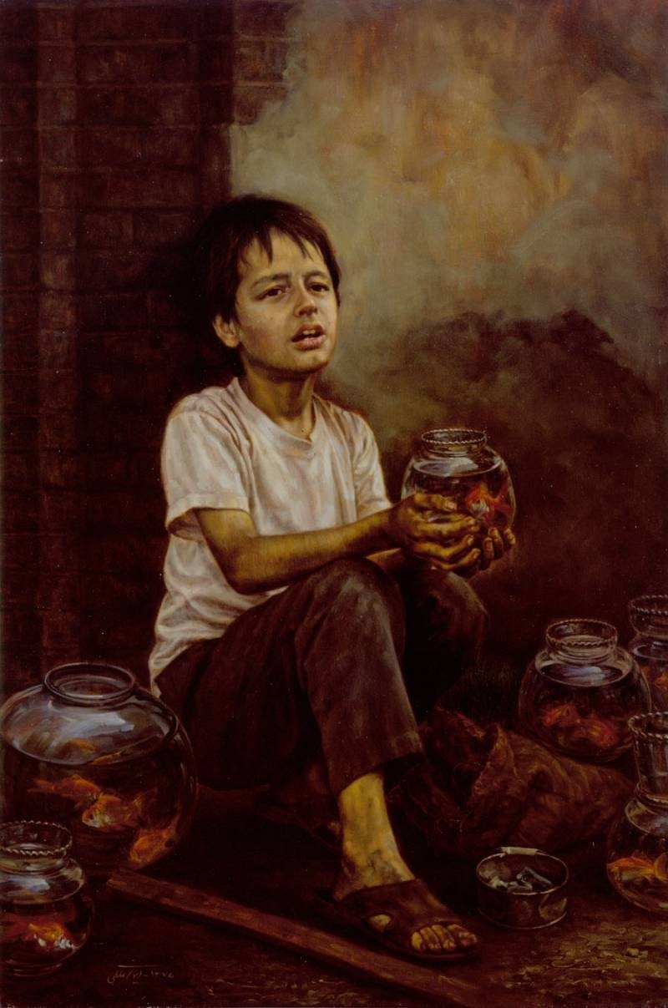
Friday Prayer
Remember that you can go to the Chapel for Confession this lunchtime.
PRAYER FOR LENT
Bless us Lord, as you call us
to walk with you on this Lenten Journey.
Bless us Lord, as you remind us
that our purpose is to please you rather than pleasing ourselves.
Bless us Lord, as we seek the good of others
in our prayers, fasting and alms-giving.
Maleki

