Slide 1
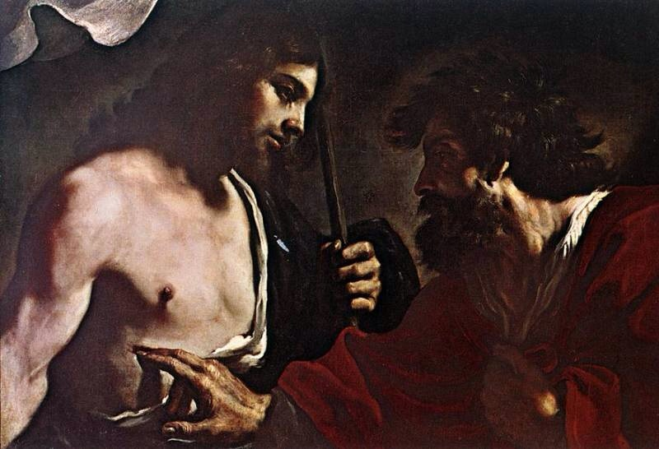
Faith
Monday Reflection
Guercino

Slide 2
Faith
Monday Prayers
Jesus said: “I am the Way, the Truth and the Life”
Let us ask him to give us an increase in the gift of faith, so that we can follow in his way.
Lord, hear us… Lord graciously hear us.
We ask God to be with us in the week ahead; May our studies bear good fruit.
Lord, hear us… Lord graciously hear us.
Let us ask Mary, Cause of our Joy,
to pray for us who have need of her prayers.
Hail Mary….

Slide 3
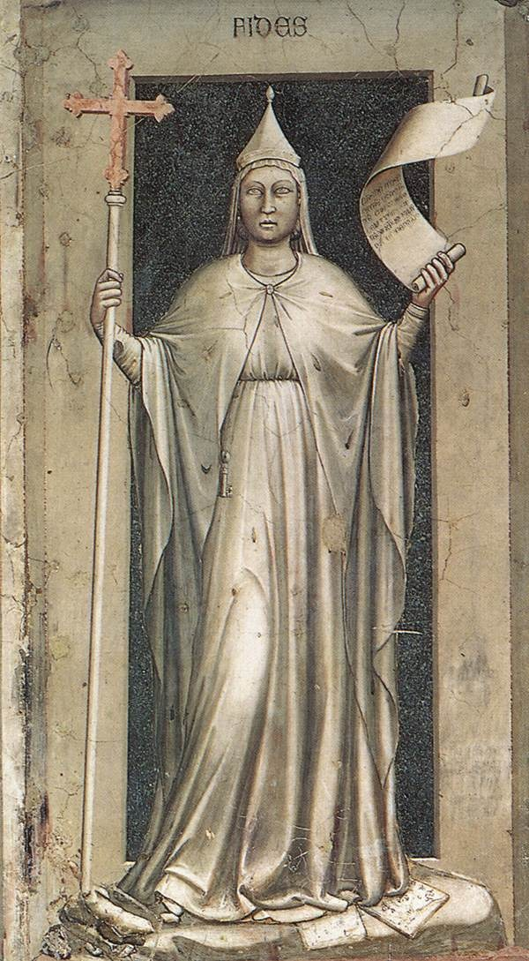
Faith
Tuesday Reflection
Giotto

Slide 4
Faith
Tuesday Prayers
Let us pray for our Holy Father Pope Leo and for the Bishops of the world;
May they be inspired to open our eyes to the beauty of the faith we profess together.
Lord, hear us…
We pray for those who represent us in Parliament and lead us in Government.
May they lead us towards what is truly good.
Lord, hear us…
St. Philip: Pray for us.
House Saint: Pray for us.
In the name of the Father…

Slide 5
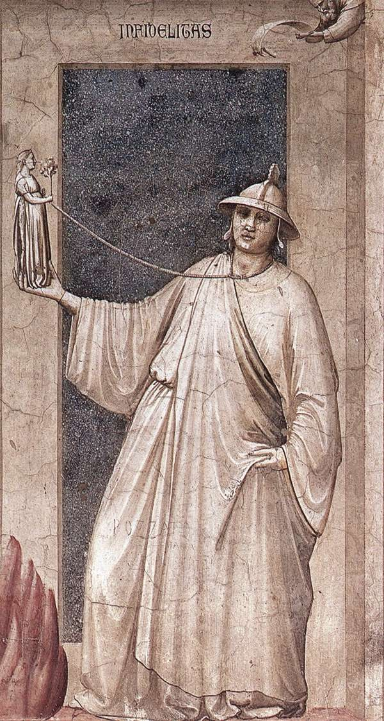
Faith
Wednesday Reflection
Giotto

Slide 6
Faith
Wednesday Prayers
Let us ask God for the gift of faith, for ourselves and for those most in need of direction in their lives.
Lord hear us…
We pray for those who have lost their faith; may the light of the Holy Spirit guide them along the right path.
Lord hear us…
St. Philip: Pray for us.
House Saint: Pray for us.
In the name…

Slide 7
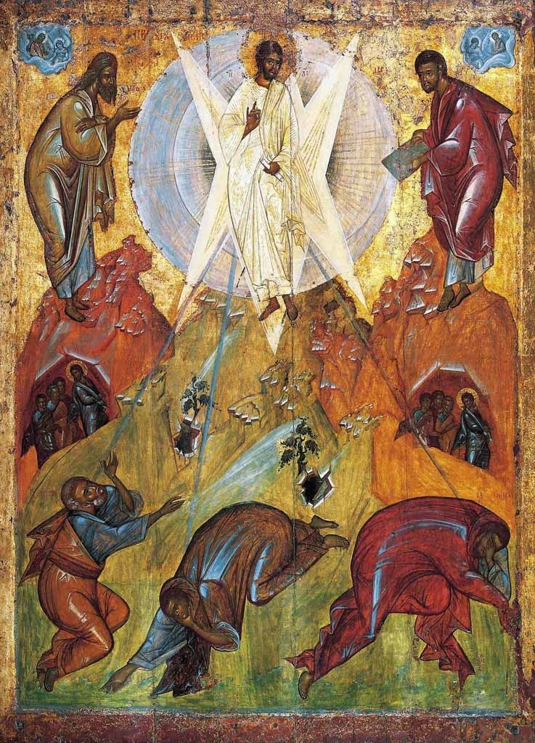
Faith
Thursday Rosary
Fourth Mystery of light:
THE TRANSFIGURATION OF JESUS
‘Jesus took with him Peter and James and John, and led them up a high mountain apart,
by themselves.
And he was transfigured before their eyes.’

Slide 8
Faith
Friday Prayer
O Gracious and Holy Father, give me wisdom to know you, intelligence to understand you, diligence to seek you,
patience to wait for you,
eyes to behold you,
a heart to meditate upon you
and a life to proclaim you,
through the power of the Spirit of Jesus Christ our Lord.
Amen.
    St. Benedict (480-547)

