Slide 1
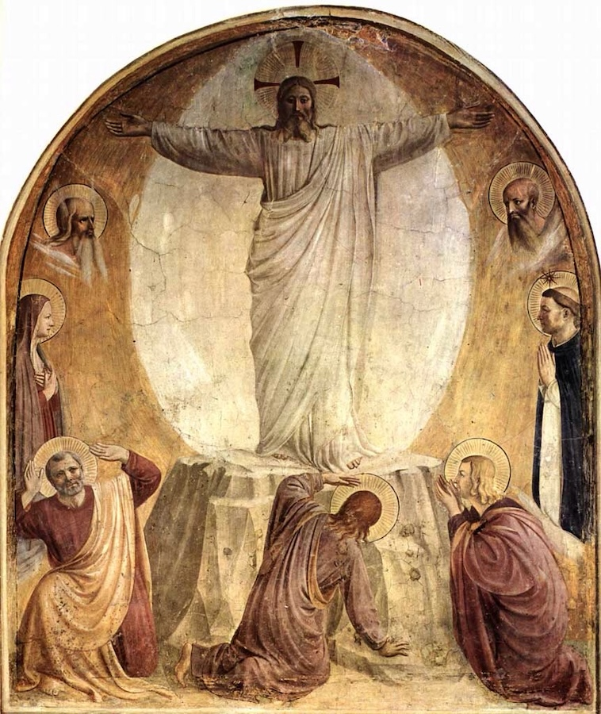
Corpus Christi
Sanctus
Monday Reflection

Slide 2
Corpus Christi
Sanctus
Monday Prayers
We pray that we might be given the grace to participate in the Mass with greater devotion.
Our Father…..
St Philip: Pray for us.
House Saint: Pray for us.
In the name…

Slide 3
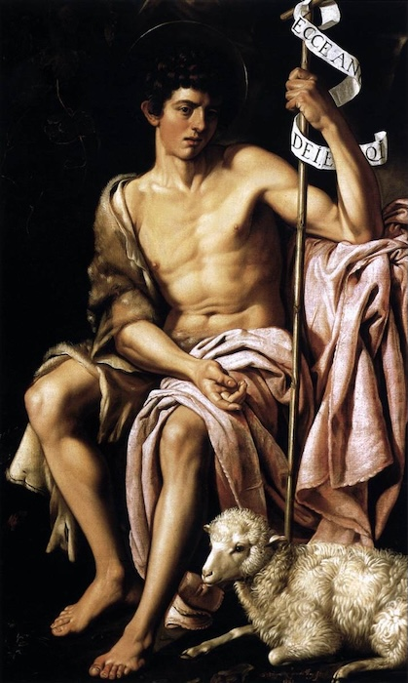
Corpus Christi
Agnus Dei
Tuesday Reflection
Bartolome Gonzalez

Slide 4
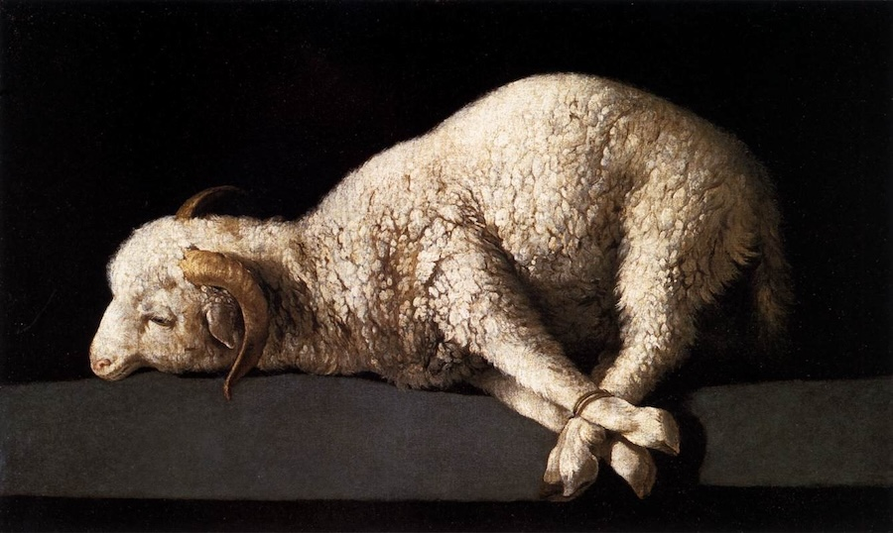
Corpus Christi
Agnus Dei
Tuesday Prayers
Zurbaran
Let us pray for the grace to celebrate Mass worthily
by becoming more aware of our need of Jesus as our Lord and Saviour.
Lord, hear us….
St Philip: Pray for us. House Saint: Pray for us. In the name…

Slide 5
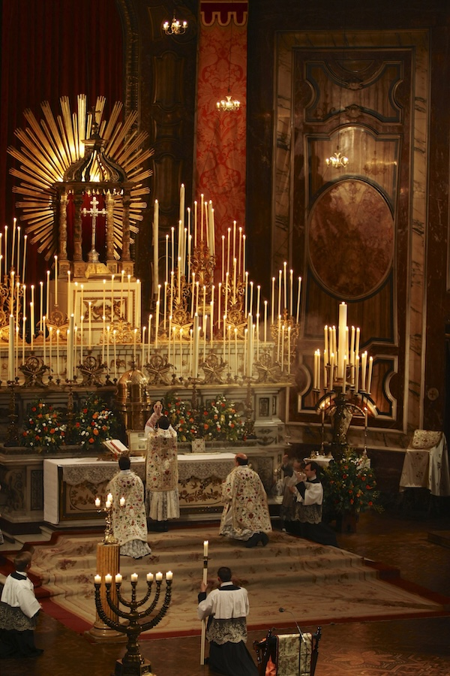
Corpus Christi
Oremus
Wednesday Reflection

Slide 6
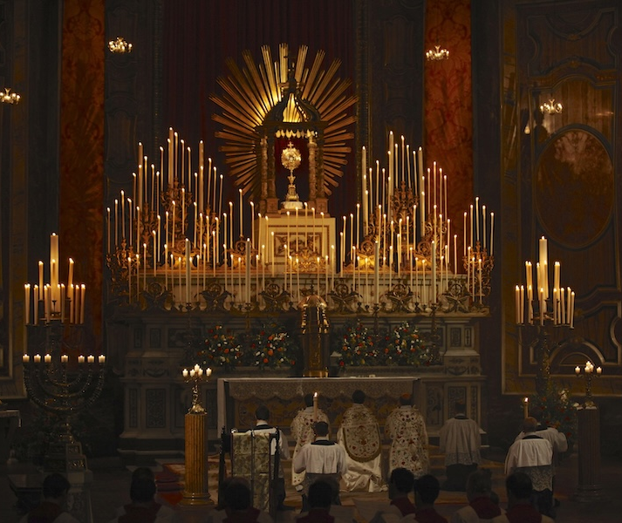
Corpus Christi
Oremus
Wednesday Prayers
Let us pray for the grace to remember to make Mass a time of prayer and thanksgiving.
Lord, hear us….
Lord, hear us…
St Philip: Pray for us.
House Saint: Pray for us.
In the name…

Slide 7
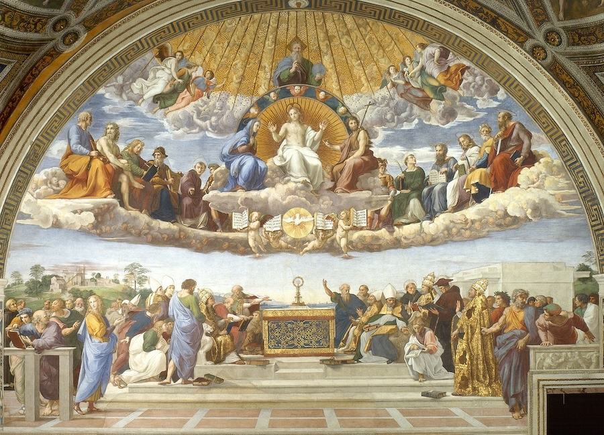
Corpus Christi
Thursday Rosary
The Fifth Luminous Mystery:
The Institution of The Eucharist
While they were eating, Jesus took a loaf of bread, and after blessing it he broke it, gave it to the disciples, and said,
‘Take, eat; this is my body.’
Raphael

Slide 8
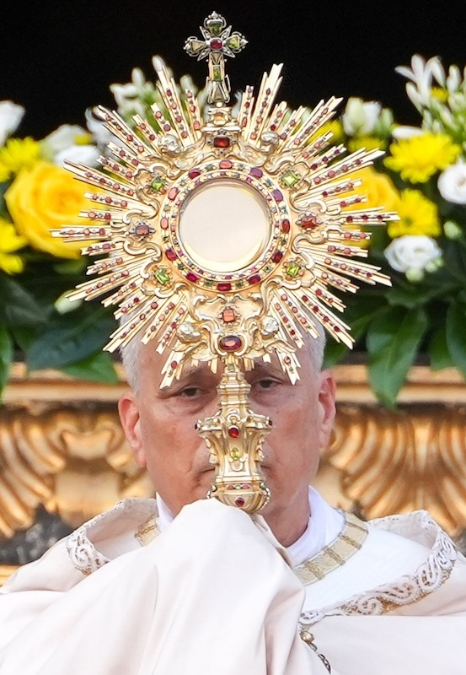
Friday Prayer
Remember that you can go to the Chapel for Confession this lunchtime.
The Anima Christi
Soul of Christ, sanctify me.
Body of Christ, save me.
Blood of Christ, fill me.
Water from the side of Christ, wash me.
Passion of Christ, strengthen me.
O good Jesus, hear me.
Suffer me not
to be separated from thee.
From the evil enemy defend me.
In the hour of death call me,
And bid me come to thee.
That with thy saints I may praise thee.
For ever and ever. Amen.

