Slide 1
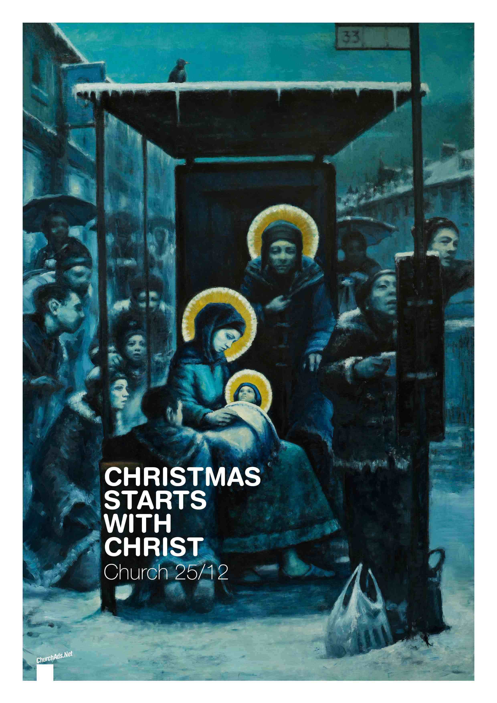
Christmas & Humility
Monday Reflection
Bus Stop Nativity

Slide 2
Christmas & Humility
Monday Prayers
Let us pray that we can learn to value humility as a virtue,
and not as a failing.
Lord hear us…
Let us ask Mary,
Mother of the Child Jesus,
to pray for us.
Hail Mary….
St. Philip: Pray for us.
House Saint: Pray for us.
In the name…

Slide 3
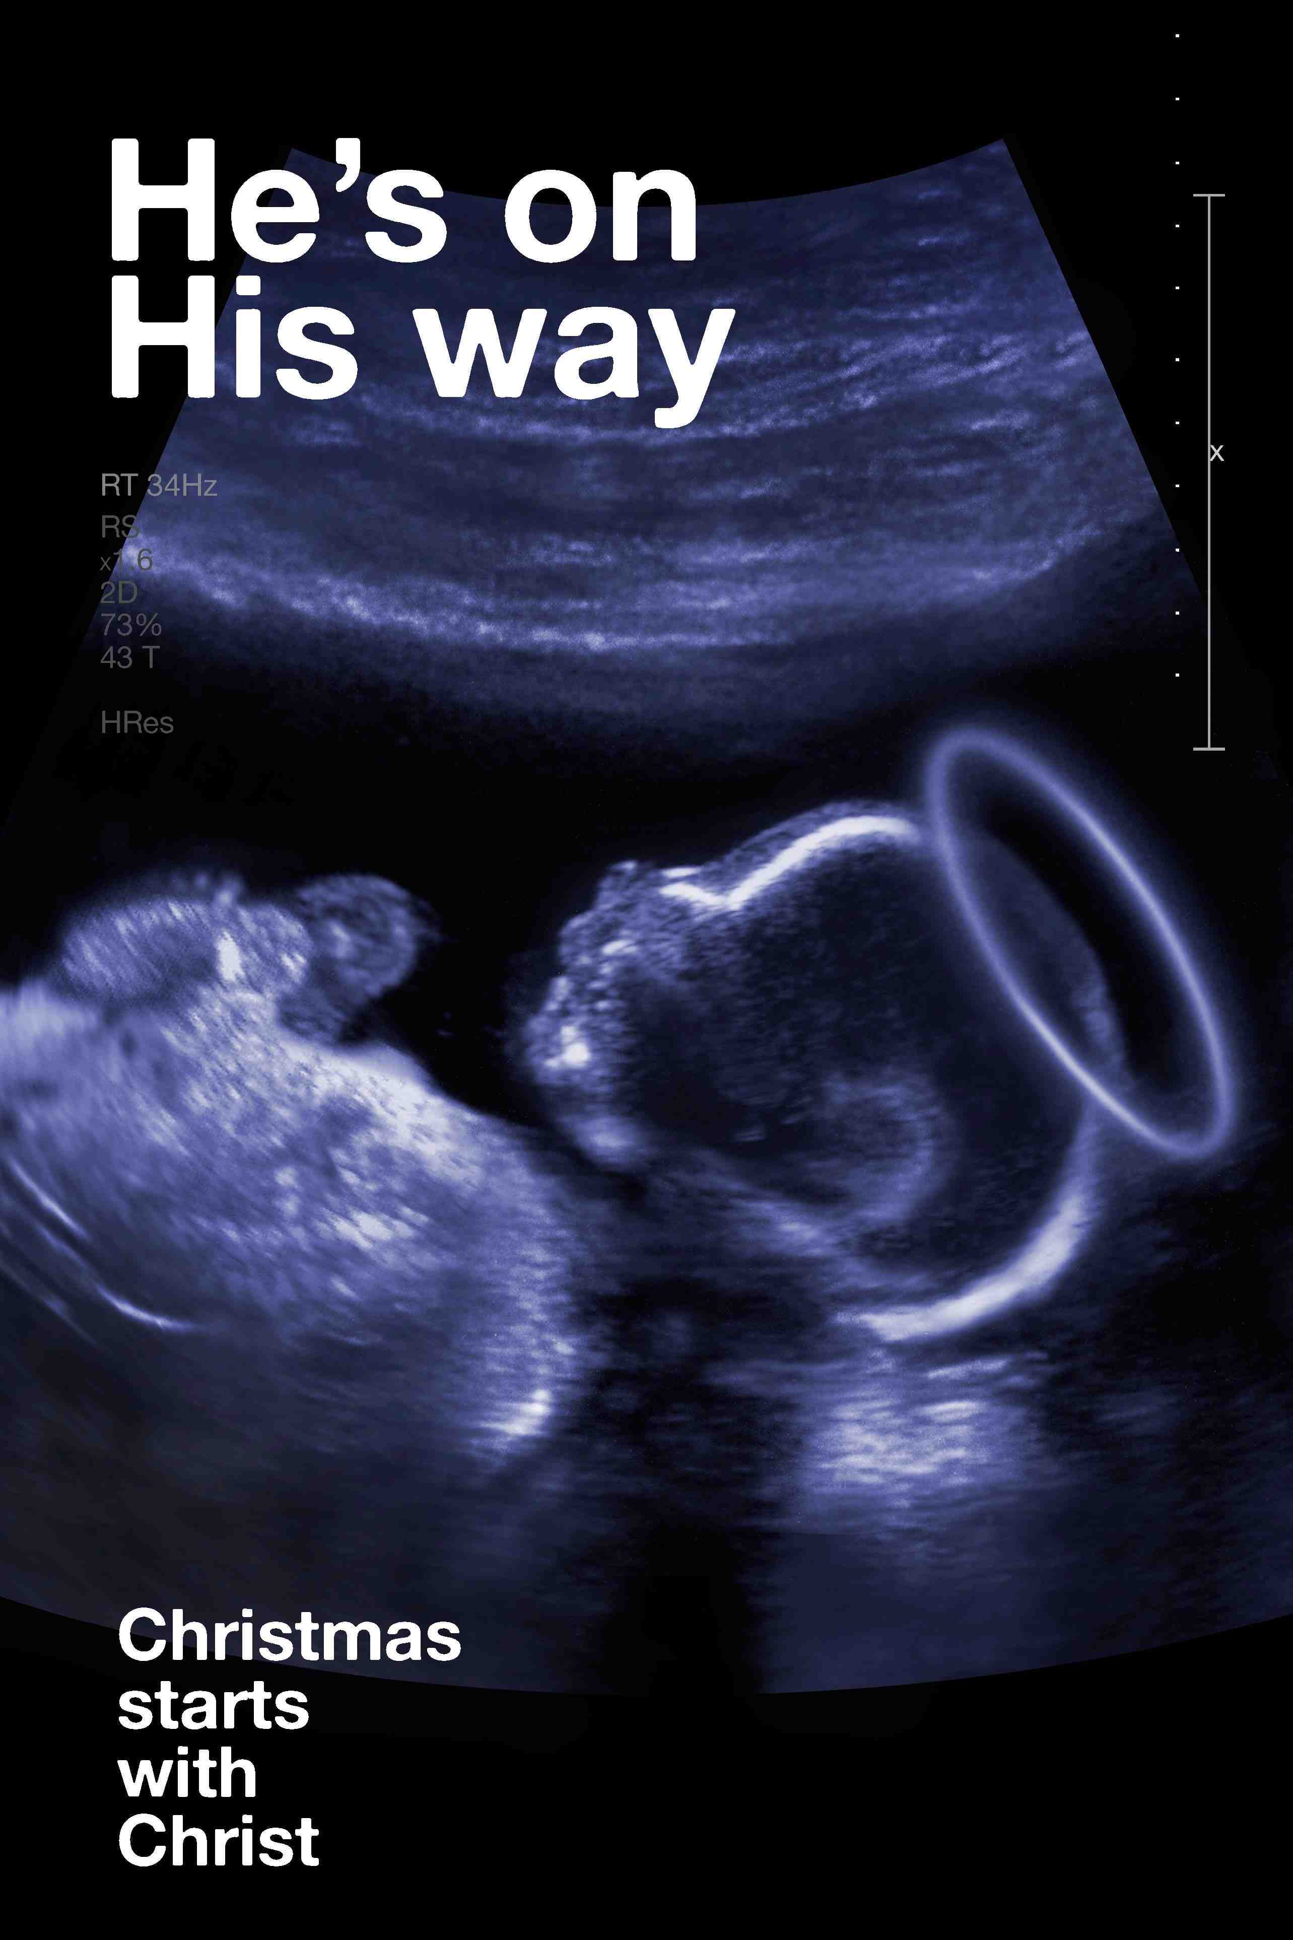
Christmas & Humility
Tuesday Reflection
Christ scan

Slide 4
Christmas & Humility
Tuesday Prayers
Let us pray for our parents and our families, that we model ourselves more on the Holy Family, as we celebrate Christmas. Lord hear us…
Let us pray for those for whom we are collecting this Advent, that they find the warmth of God’s love in the season of Christmas.
Lord hear us…
Lord hear us…
St. Philip: Pray for us.
House Saint: Pray for us.
In the name…

Slide 5
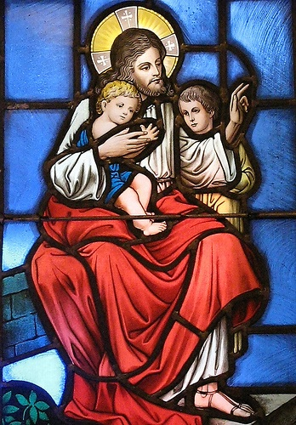
Christmas & Humility
Wednesday Reflection

Slide 6
Christmas & Humility
Wednesday Prayers
Let us pray for those for whom we are collecting this Advent, that they find the warmth of God’s love in the season of Christmas.
Lord hear us…
Let us ask Mary, Mother of God,
to pray for our families this Christmas
Hail Mary…
St. Philip: Pray for us.
House Saint: Pray for us.
In the name …

Slide 7
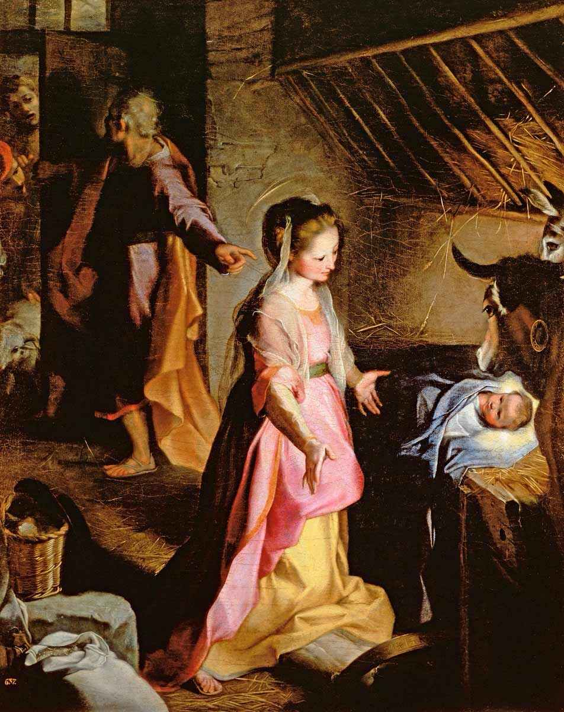
Christmas & Humility
Thursday Rosary
Third Joyful Mystery:
THE NATIVITY
Mary gave birth to her firstborn son
and wrapped him in bands of cloth,
and laid him in a manger,
because there was no place for them in the inn.
Baroccio

Slide 8
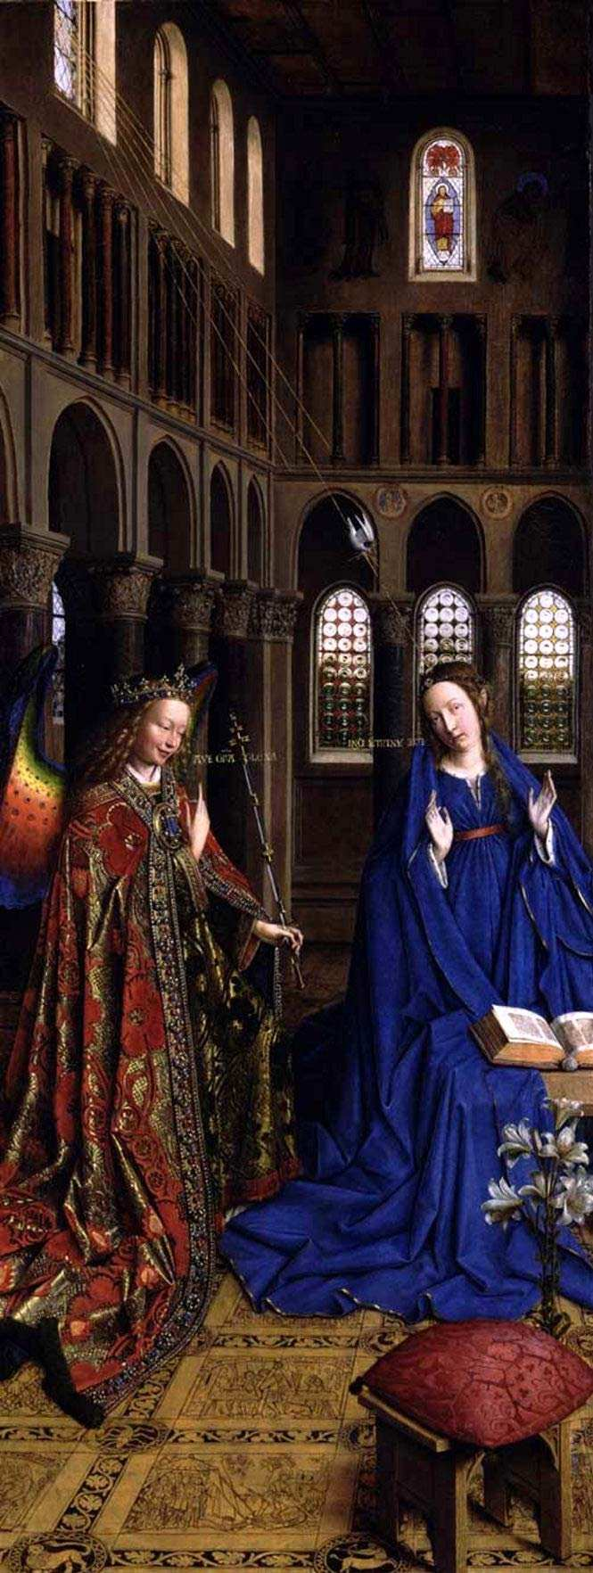
Advent Friday Prayer
Remember that you can go to the Chapel for Confession this lunchtime.
Thomas Aquinas
PRAYER FOR A WATCHFUL HEART
Grant me, O Lord my God
a mind to know you,
a heart to seek you,
wisdom to find you,
conduct pleasing to you,
faithful perseverance in waiting for you,
and a hope of finally embracing you.
Through Christ our Lord,
Amen.
Van Eyck

