Slide 1
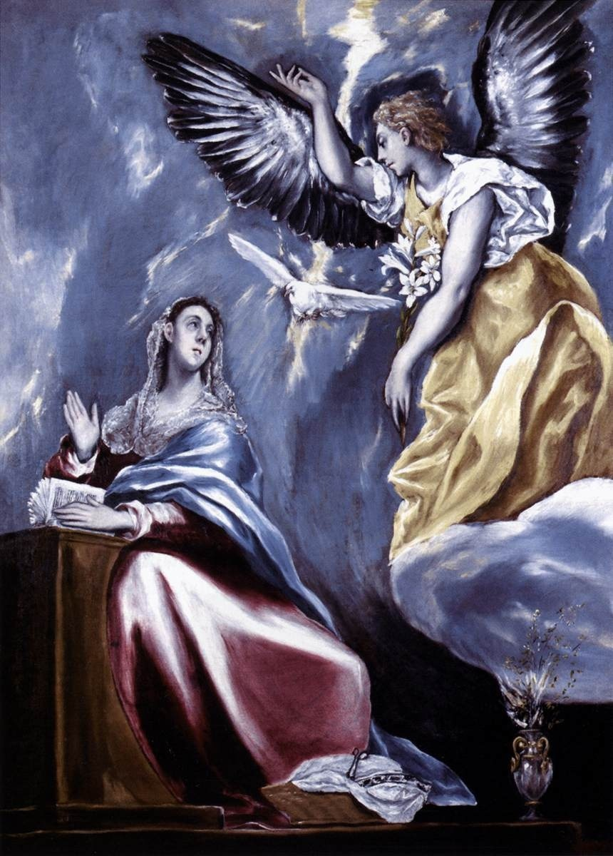
Amen
Monday Reflection
El Greco

Slide 2
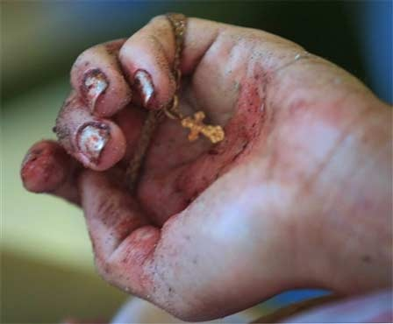
Amen
Monday Prayers
Let us pray for those whom we will be helping by our charitable work this Lent. May our efforts bring them hope in their times of trial and hardship.
Lord, hear us…
Let us ask Our Lady to pray for us, that we have the courage to commit ourselves more fully to her son Jesus.
Hail Mary....
In the name…

Slide 3
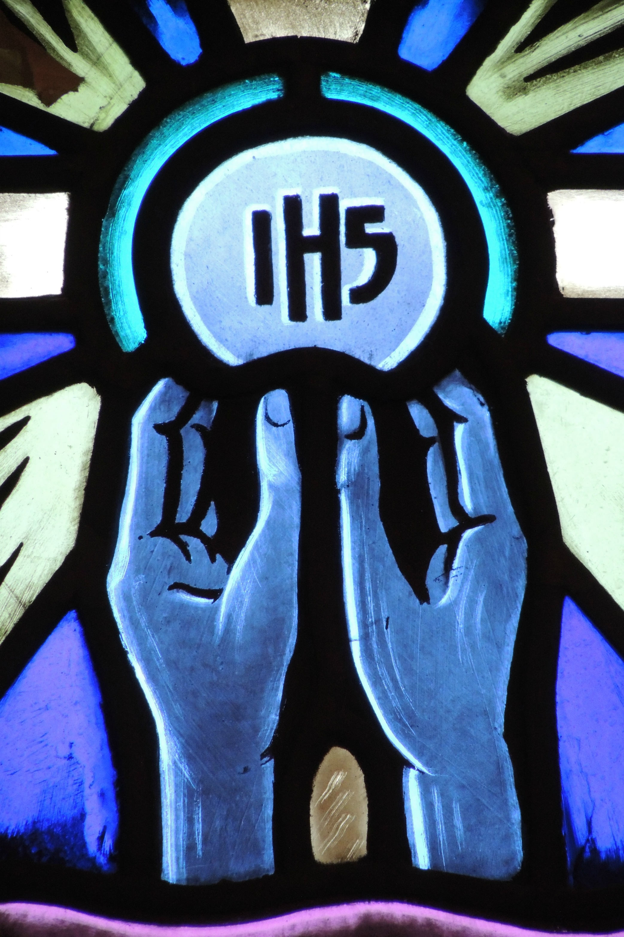
Amen
Tuesday Reflection

Slide 4
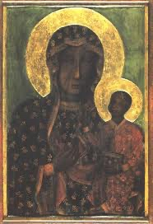
Amen
Tuesday Prayers
Let us ask Our Lady to pray for us, that we have the courage to commit ourselves more fully to her son Jesus.
Hail Mary.…
In the name….
Our Lady of Czestochowa

Slide 5
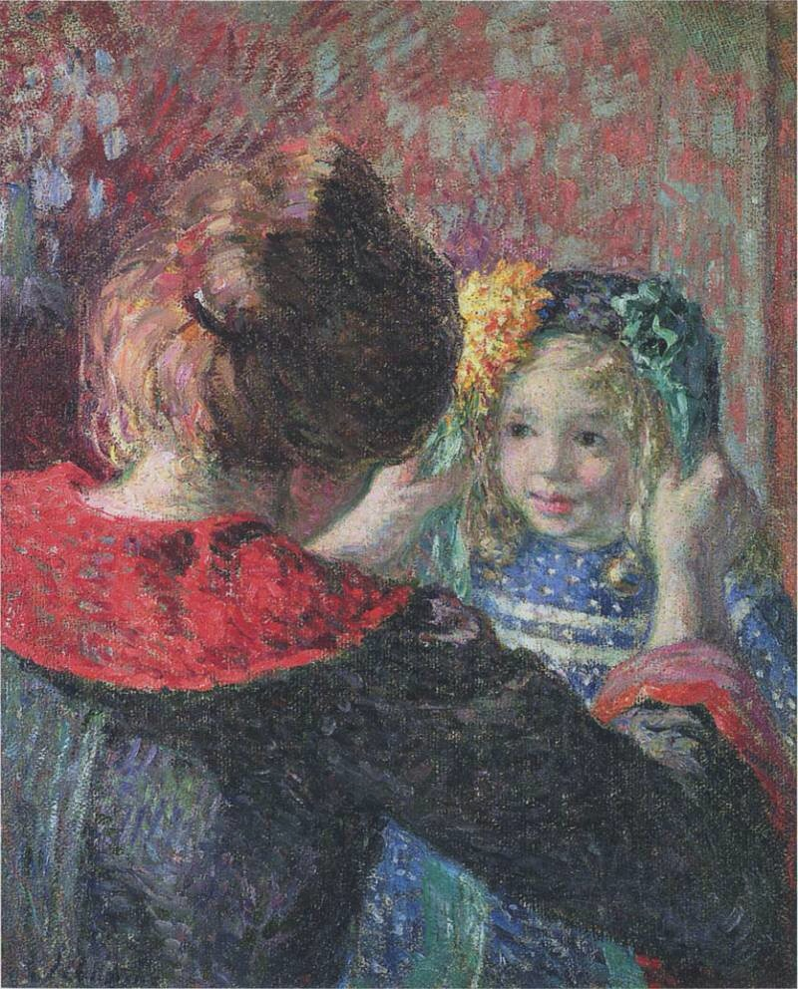
Amen
Wednesday Reflection
Henri Lebrasque

Slide 6
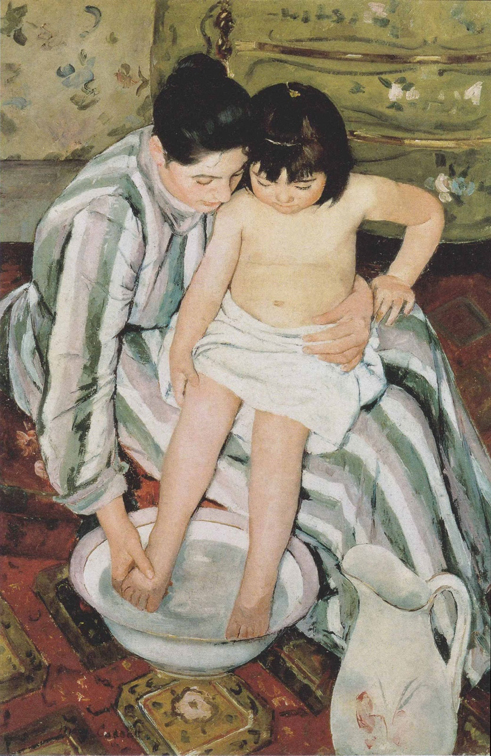
Amen
Wednesday Prayers
Let us pray for our mothers, giving thanks for all that they do for us, and asking for them to be filled with God’s grace.
Hail Mary…
In the name…
Cassatt

Slide 7
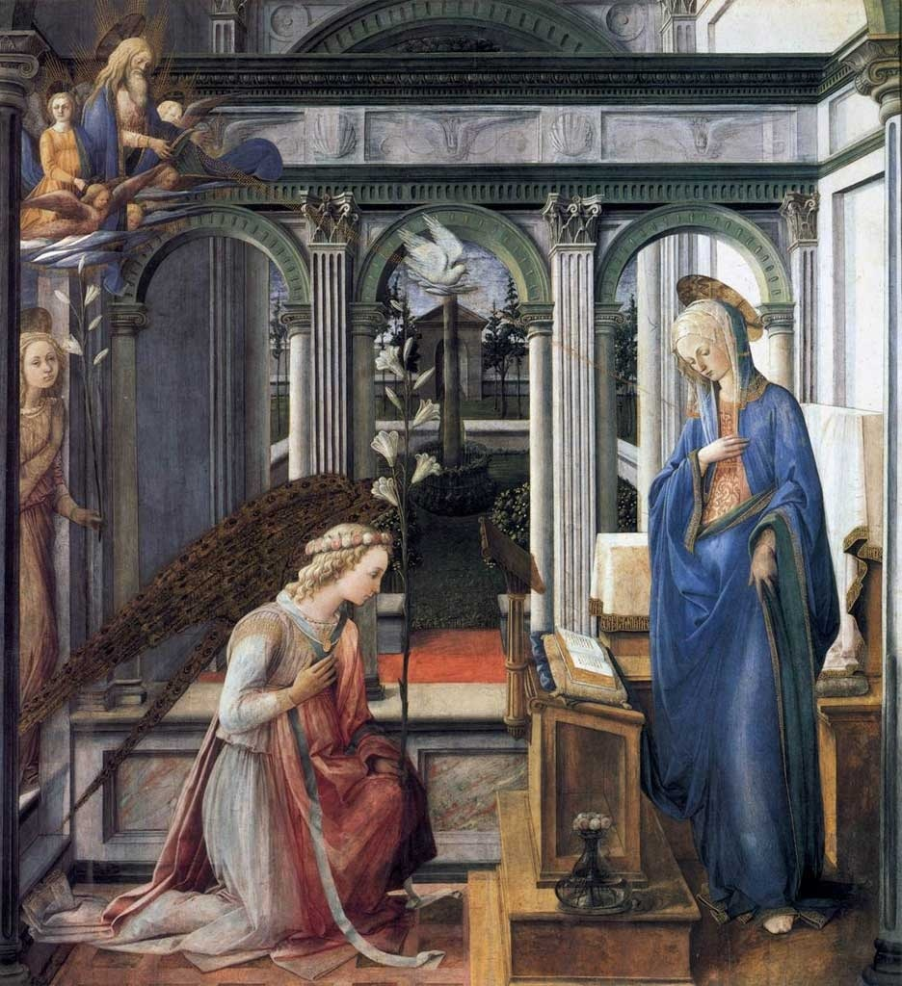
Amen
Thursday Rosary
Lippi
The First Joyful Mystery:
THE ANNUNCIATION
The angel said to Mary, ‘Do not be afraid, Mary, for you have found favour with God.
And now, you will conceive in your womb and bear a son, and you will name him Jesus.’

Slide 8
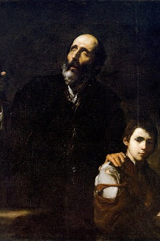
Friday Prayer
Remember that you can go to the Chapel for Confession this lunchtime.
PRAYER FOR LENT
Bless us Lord, as you call us
to walk with you on this Lenten Journey.
Bless us Lord, as you remind us
that our purpose is to please you rather than pleasing ourselves.
Bless us Lord, as we seek the good of others
in our prayers, fasting and alms-giving.
Ribera

