Slide 1
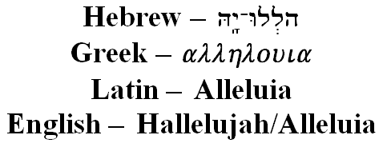
Alleluia
Monday Reflection

Slide 2
Alleluia
Monday Prayers
For each of these prayers we respond Alleluia.
Let us praise the Lord for giving us the gift of life.
Alleluia.
Let us praise Him for saving us from death.
Alleluia.
Let us praise Him for His merciful love to us.
Alleluia.
Then say in Latin:
Haec Dies quam fecit Dominus, Alleluia!
Exultemus et laetemur in ea, Alleluia!
…or in English:
This is the Day that was made by the Lord, alleluia!
We rejoice and are glad, Alleluia!

Slide 3
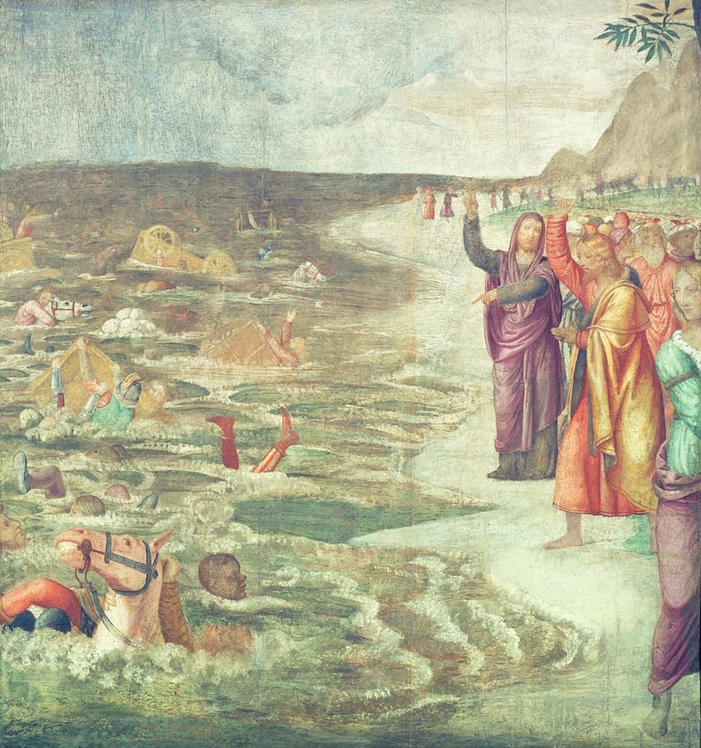
Alleluia
Tuesday Reflection
Luini

Slide 4
Alleluia
Tuesday Prayers
For each of these prayers we respond Alleluia.
Let us praise the Lord for giving us the gift of life.
Alleluia.
Let us praise Him for saving us from death.
Alleluia.
Let us praise Him for His merciful love to us.
Alleluia.
Then say in Latin:
Haec Dies quam fecit Dominus, Alleluia!
Exultemus et laetemur in ea, Alleluia!
…or in English:
This is the Day that was made by the Lord, alleluia!
We rejoice and are glad, Alleluia!

Slide 5
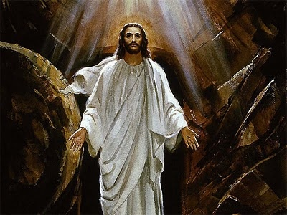
Alleluia
Wednesday Reflection

Slide 6
Alleluia
Wednesday Prayers

Slide 7
Alleluia
Thursday Rosary
The First Glorious Mystery
THE RESURRECTION
Jesus rose from the dead early
on the first day of the week;
The Day that was made by the Lord
for his work of salvation.
Alleluia!
James Martin

Slide 8
Friday Prayer
THE FORM TEACHER NEEDS TO LOG IN!
Go to this link to hear Gregorian chant of an Alleluia antiphon…
Click to open link

