Slide 1
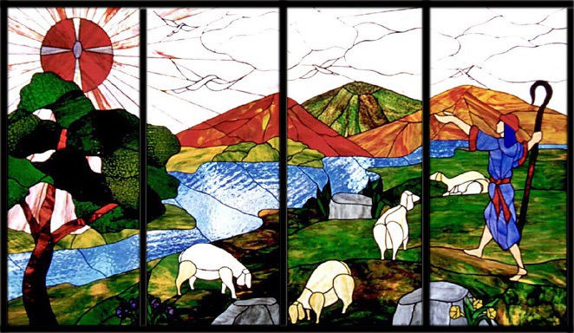
First Day - Staff
Open Gates
Reflection

Slide 2
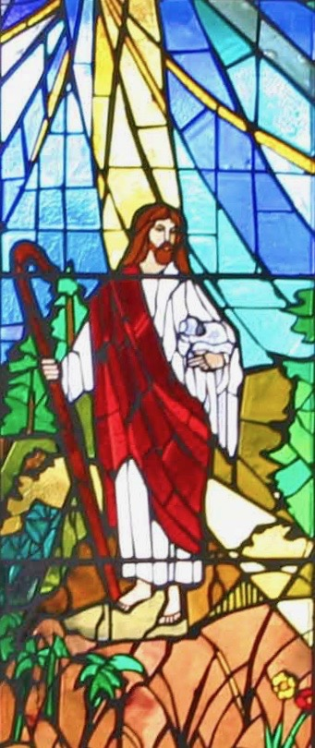
First Day - Staff
Open Gates
Prayers
Let us pray for the pupils that we will educate in the year ahead; May they grow in the knowledge and love of God and of one another by our example.
Lord, hear us...
Let us pray for the new members of staff in our school; May they find in us a community that reflects the commandment to love and to serve.
Lord, hear us....
Let us pray for ourselves; May we never cease to search for the Truth, and discover the way towards the fullness of life in God. Lord hear us…
St Philip: Pray for us.
St John Henry Newman: Pray for us.
In the name…

Slide 3
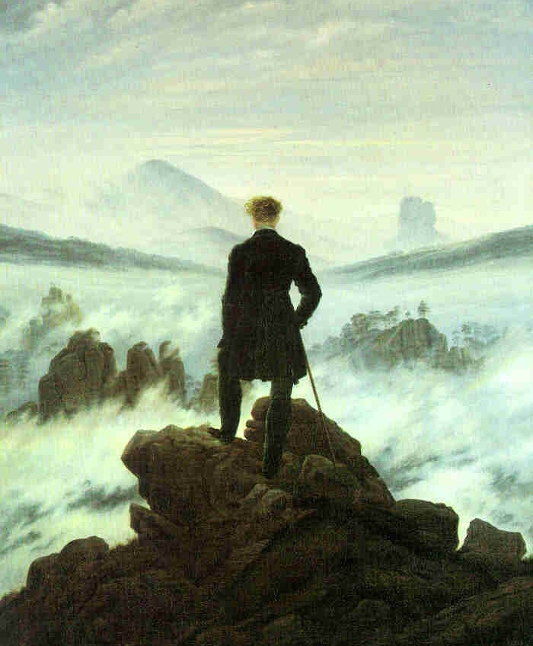
First Day, Opening Week - Pupils
Adventures
Reflection
Friedrich

Slide 4
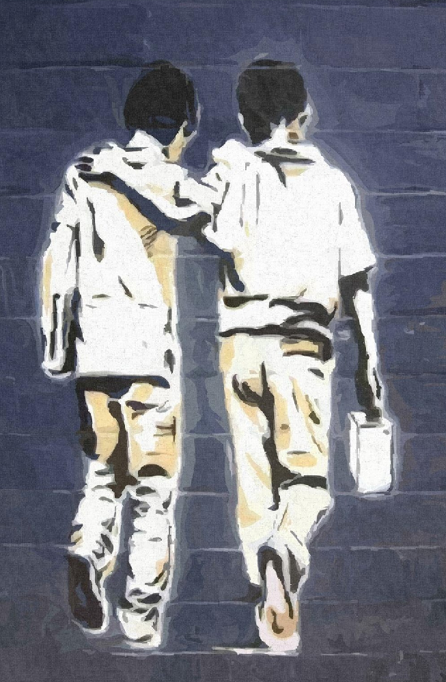
First Day, Opening Week - Pupils
Adventures
Prayers
Let us pray for the gift of Courage;
May we be inspired to rise to the challenges that will confront us in the year ahead.
Lord hear us… Lord, graciously hear us.
Let us pray for our parents; May they support the school in helping us learn how to know and love God.
Lord, hear us… Lord, graciously hear us.
Saint Philip Neri, Founder of the Oratory…
Pray for us.
Saint John Henry Newman,
Founder of the Oratory in England…
Pray for us.
Banksy

Slide 5
Second Day, Opening Week
The Birthday of the Blessed Virgin Mary
Reflection
Guido Reni

Slide 6
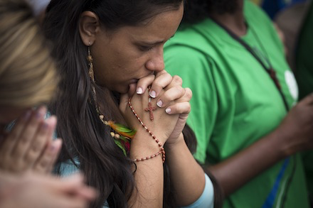
Second Day, Opening Week
The Birthday of the Blessed Virgin Mary
Hail Mary,
Full of grace, the Lord is with thee.
Blessed art thou amongst women, and blessed is the fruit of thy womb,
Jesus.
Holy Mary, Mother of God, pray for us sinners,
Now, and at the hour of our death.
Amen.

Slide 7
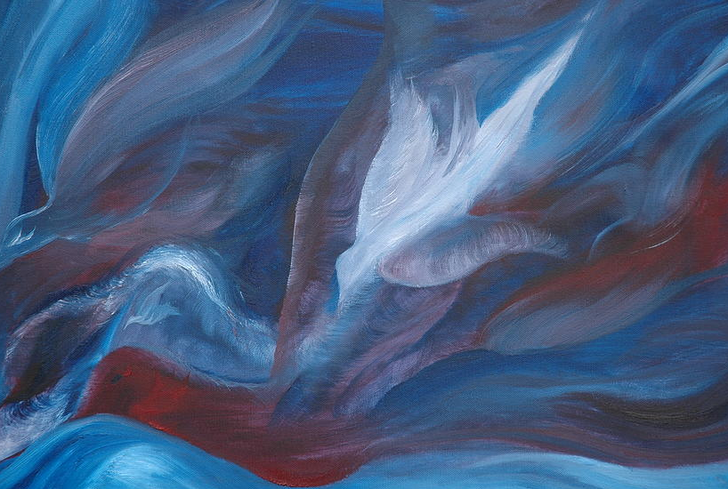
Third Day, Opening Week
Praying to the Holy Spirit
Reflection
Colleen Shay

Slide 8
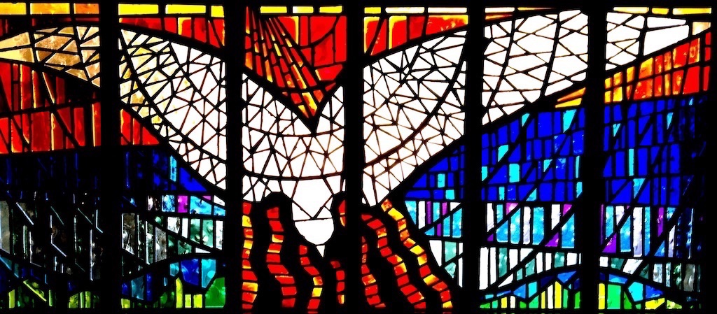
Third Day, Opening Week
PRAYER TO THE HOLY SPIRIT
Let say this prayer together for the year ahead…
Come Holy Spirit, fill the hearts of your faithful,
and enkindle within them the fire of your love.
Send forth your Spirit and they shall be created.
And you will renew the face of the earth.
Glory be to the Father and to the Son,
and to the Holy Spirit.
As it was in the beginning,
is now and ever shall be, world without end, Amen.

Slide 9
Rest of the Opening Week
PRAYER TO THE HOLY SPIRIT
Let say this prayer together for the year ahead…
Come Holy Spirit, fill the hearts of your faithful,
and enkindle within them the fire of your love.
Send forth your Spirit and they shall be created.
And you will renew the face of the earth.
Glory be to the Father and to the Son,
and to the Holy Spirit.
As it was in the beginning,
is now and ever shall be, world without end, Amen.

